Slide 1
How Canada Compares
Chartbook | February 2018
Results From The Commonwealth Fund’s 2017 International Health Policy Survey of Seniors

Slide 2
Production of this document is made possible by financial contributions from Health Canada and provincial and territorial governments. The views expressed herein do not necessarily represent the views of Health Canada or any provincial or territorial government.
Unless otherwise indicated, this product uses data provided by Canada’s provinces and territories.
All rights reserved.
The contents of this publication may be reproduced unaltered, in whole or in part and by any means, solely for non-commercial purposes, provided that the Canadian Institute for Health Information is properly and fully acknowledged as the copyright owner. Any reproduction or use of this publication or its contents for any commercial purpose requires the prior written authorization of the Canadian Institute for Health Information. Reproduction or use that suggests endorsement by, or affiliation with, the Canadian Institute for Health Information is prohibited.
For permission or information, please contact CIHI:
Canadian Institute for Health Information
495 Richmond Road, Suite 600
Ottawa, Ontario K2A 4H6
Phone: 613-241-7860
Fax: 613-241-8120
www.cihi.ca
copyright@cihi.ca
ISBN 978-1-77109-673-7
© 2018 Canadian Institute for Health Information
How to cite this document:
Canadian Institute for Health Information. How Canada Compares: Results From The Commonwealth Fund’s 2017 International Health Policy Survey of Seniors. Ottawa, ON: CIHI; 2018.
Cette publication est aussi disponible en français sous le titre Résultats du Canada : Enquête internationale de 2017 du Fonds du Commonwealth sur les politiques de santé auprès des adultes âgés.
ISBN 978-1-77109-674-4

Slide 3
Table of contents
Executive summary 4
Acknowledgements 8
About this chartbook 10
Setting the context: Patients’ interactions with their health system 12
Patients’ experiences with their health system 13
Health of Canadian seniors 14
Perceived quality of health care 29
Access to primary health care 32
Primary health care 37
Coordination 45
Specialist care and coordination with primary health care 51
Hospital care and coordination 56
Home care 63
End-of-life planning and medical assistance in dying 71
Methodology notes 75
Demographics of survey respondents 78
Bibliography 79

Slide 4
Executive summary
Health of Canadian seniors
• 8 out of 10 Canadian seniors — a higher proportion than the international average — rate their health as excellent, very good or good.
• However, many Canadian seniors face problems with their health and well-being, more so than seniors in other countries. A third live with at least 3 chronic conditions, 32% take 5 or more regular medications and 14% face a mental health problem such as depression or anxiety.
• 9% of Canadian seniors worry about not having enough money to buy nutritious meals or to pay for housing or other bills; this proportion is similar in other countries. 18% cannot pay for dental care, higher than the international average.
Perceived quality of health care
Canada continues to perform below the international average (76%), with only two-thirds of Canadian seniors (67%) being satisfied with the overall quality of the health care they received; however, they report better experiences with their primary health care provider than the international average.
Access to primary health care
Canada continues to perform below the international average for timely access to primary health care (44%), with almost two-thirds (59%) of seniors unable to get a same- or next-day appointment.
Close to two-thirds (62%) of Canadian seniors had difficulty getting medical care after hours without going to the hospital emergency department (ED). Consequently, almost a third (31%) reported that the last time they went to the ED, it was for a condition that could have been treated by their regular doctor.
© 2018 Canadian Institute for Health Information

Slide 5
Executive summary (cont’d)
Primary health care
Generally, Canadians report better experiences with their primary health care provider than the international average, with respect to their regular doctor knowing their medical history, involving them in medical decisions, spending enough time with them and encouraging them to ask questions.
When it comes to managing the complex medical needs of seniors, the majority of Canadian seniors (82%) — more than the international average — had a medication review within the past 12 months as well as a treatment plan for their chronic conditions.
Only 65% have a health care professional they can easily contact to ask a question between doctor visits, and even fewer (14%) have a health care professional contacting them between doctor visits; both of these proportions are below the international average.
While better than the international average, 59% of Canadian seniors are not very confident in managing their own health problems.
Canadian seniors are more likely to discuss healthy lifestyle choices with their care providers, but gaps remain. For instance, close to half did not discuss a healthy diet or exercise.
© 2018 Canadian Institute for Health Information

Slide 6
Executive summary (cont’d)
Coordination
Well-coordinated care is especially important for seniors. 1 out of 7 seniors saw at least 4 doctors in the previous 12 months. Primary health care providers play an essential role in both providing and coordinating care. 82% of Canadian seniors said their regular doctor helps coordinate care from other places, which is above the international average.
Some Canadian seniors face coordination problems. 12% said medical test results were unavailable at their appointment, 11% had received conflicting information from different health care providers and 8% thought a medical mistake had been made in their treatment or care. For the most part, these results are similar to the international average.
Specialist care
Results suggest that access to and coordination of specialist care could be improved. Canadian seniors had the longest wait times for specialists, with 3 out of 5 waiting at least 4 weeks for an appointment.
As well, 5% of seniors said their specialist did not have basic medical information from their regular doctor, while 13% said their regular doctor did not seem informed about the specialist care they’d received. Both results are close to the international average.
Hospital care
Although Canada’s results are very similar to the international average, gaps remain in communication and hospital discharge planning for seniors. 1 out of 5 did not receive written information on what to do after discharge or did not have follow-up care arranged. One-quarter of seniors (27%) did not have someone review the purpose of each of their medications with them.
1 out of 10 Canadian seniors said that their regular doctor did not seem informed about their hospital care.
© 2018 Canadian Institute for Health Information

Slide 7
Executive summary (cont’d)
Home care (Canada only)
11% of Canadian seniors had help with certain activities of daily living; most of them (4 out of 5) received it from a family member or friend.
1% of Canadian seniors reported needing help with activities of daily living but not receiving it.
6% of Canadian seniors received publicly funded home care services. The majority were satisfied with the services received and with the coordination between their home care provider and their regular health care professional. They felt these services helped them stay at home.
3% of Canadian seniors felt they needed publicly funded home care services but did not receive them.
End-of-life planning and medical assistance in dying
More Canadian seniors have engaged in end-of-life care planning than seniors in other countries. Approximately two-thirds have discussed their end-of-life care wishes with someone (66%) and have documented a substitute decision-maker (63%). In contrast, less than half (44%) have a written plan or document describing their end-of-life care wishes.
For the first time, survey respondents were asked about medical assistance in dying (MAID). 12% of Canadian seniors or a family member have talked to a health care provider about access to MAID, and 64% are confident or very confident that they would be able to obtain MAID in their community if they were eligible and wished to receive it. (Canada only)
© 2018 Canadian Institute for Health Information

Slide 8
Acknowledgements
Core funding for The Commonwealth Fund’s 2017 International Health Policy Survey of Seniors was provided by The Commonwealth Fund (CMWF) with co-funding from the following organizations outside of Canada:
The New South Wales Bureau of Health Information (Australia); the Victoria Department of Health and Human Services (Australia); the Haute autorité de santé (France); the Caisse nationale de l’assurance maladie des travailleurs salariés (France); the Institute for Quality Assurance and Transparency in Healthcare (IQTIG) (Germany); the Scientific Institute for Quality of Healthcare, Radboud University Nijmegen (the Netherlands); the Dutch Ministry of Health, Welfare and Sport (the Netherlands); the Norwegian Knowledge Centre at the Norwegian Institute of Public Health; the Swedish Ministry of Health and Social Affairs; the Swedish Agency for Health and Care Services Analysis (Vårdanalys); the Swiss Federal Office of Public Health; and other country partners.
Within Canada, funding for an expanded Canadian sample was provided by the Canadian Institute for Health Information (CIHI), the Commissaire à la santé et au bien-être du Québec and Health Quality Ontario.
© 2018 Canadian Institute for Health Information

Slide 9
Acknowledgements (cont’d)
CIHI would like to acknowledge and thank the many individuals who assisted with the development of this chartbook, including our Expert Advisory Group:
Dr. Mike Benigeri, Consultant, Commissaire à la santé et au bien-être du Québec
Dr. Gail Dobell, Director, Performance Measurement, Health Quality Ontario
Dr. Alan Katz, Director, Manitoba Centre for Health Policy, University of Manitoba
Dr. Jean-Frédéric Levesque, Chief Executive, Agency for Clinical Innovation, New South Wales, Australia
Annette McKinnon, patient representative
Michelina Mancuso, Executive Director, Performance Measurement, New Brunswick Health Council
Sukirtha Tharmalingam, Manager, Evaluation Methods, Canada Health Infoway
Please note that the analyses and conclusions in the present document do not necessarily reflect those of the individuals or organizations mentioned above.
Appreciation goes to the CIHI staff on the core team as well as in the supporting program areas who contributed to the development of this project. Core team members who contributed to this chartbook include Grace Cheung, Gilles Fortin, Katerina Gapanenko, Tracy Johnson, Christopher Kuchciak, Kathleen Morris, Geoff Paltser, David Paton, Patricia Sidhom, Alain Yao, Jingbo Zhang and Annie Zhao.
© 2018 Canadian Institute for Health Information

Slide 10
About this chartbook
The 2017 edition of The Commonwealth Fund International Health Policy Survey focused on the views and experiences of seniors (age 65 and older) in 11 developed countries. This chartbook highlights the Canadian story of seniors’ interactions with their health system, and it examines how these experiences vary across Canada relative to comparator countries and how they are changing over time.
Supplementary data tables are available online. These show more detailed responses to the questions presented here as well as some additional questions not covered in this chartbook. Full data sets of the survey results are available to researchers upon request by writing to cmwf@cihi.ca. As well, an accessible PDF version of this chartbook is available on CIHI’s website.
Interpreting results
CIHI applied statistical methods to determine whether Canadian and provincial results were significantly different from the international average of 11 countries.
Results are displayed throughout the chartbook using the following colour codes:
Above-average results are more desirable relative to the international average, while below-average results often indicate areas for improvement.
New in this year’s report: predictive analysis was conducted for Canada to identify significant relationships between survey questions.
Above average
Same as average
Below average
© 2018 Canadian Institute for Health Information

Slide 11
About this chartbook (cont’d)
Interpreting results (cont’d)
Sample sizes in some provinces are much smaller than in others and have wider margins of error. For this reason, 2 provinces may have the same numeric results with different significance testing relative to the international average.
In conducting the survey, efforts were made to ensure a representative and diverse sample that covers the target population — adults age 65 and older in Canada. The sampling design for the Canadian survey covered more than 95% of in-service landline numbers, including telephone numbers of people in long-term care residential facilities. However, a potential bias may exist, given that the survey excludes seniors who were physically or cognitively unable to complete the survey at the time it was conducted. This caveat applies to the other countries as well.
The most robust samples are in Quebec and Ontario because of the additional funding provided from these provinces. The overall response rate for the survey in Canada was 23.2%, for a total of 4,549 respondents.
The maple leaf symbol indicates that the question was part of the Canadian survey only and was not asked in other countries. International comparison is therefore not possible.
To provide additional context, this chartbook also references information from CIHI and other sources. References (marked with these symbols: * † ‡ § **) can be found in the notes panels of applicable slides.
© 2018 Canadian Institute for Health Information

Slide 12
Setting the context: Patients’ interactions with their health system
Delivering patient-centred care is a health system goal in Canada and many other developed countries. By comparing Canadian seniors’ experiences and interactions across their health care system with those of seniors in 10 other developed countries, this chartbook provides important perspective on how well health systems in Canada are meeting the needs and expectations of seniors.
At the centre of the patient’s interactions is the primary health care physician who provides essential care, as well as necessary coordination across various components of a health care system, including specialist care, hospital care, home care and end-of-life planning. This chartbook provides information on the experience of seniors with each of these components.
© 2018 Canadian Institute for Health Information

Slide 13
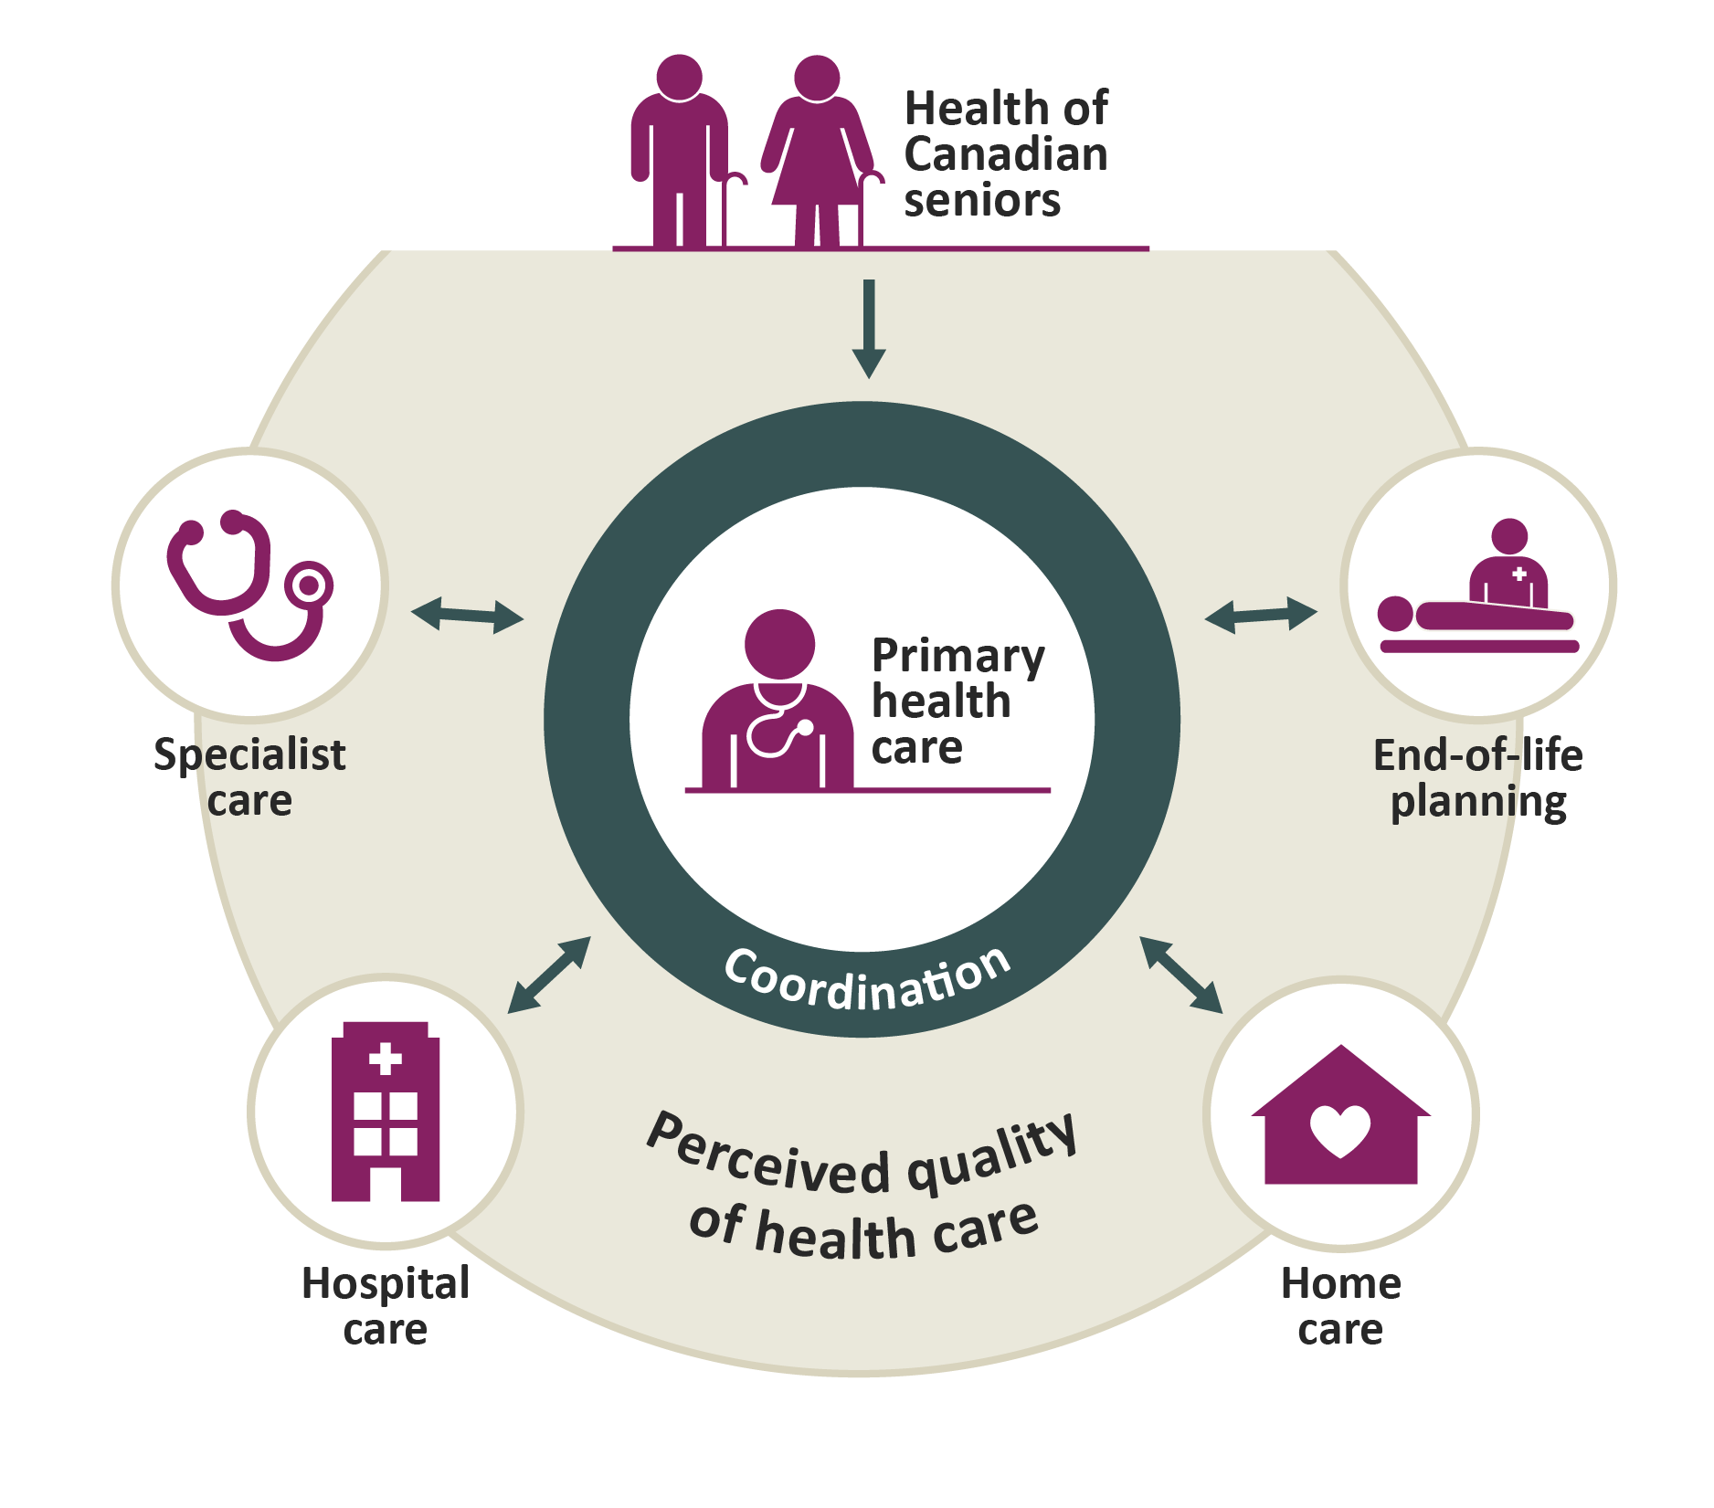
Patients’ experiences with their health system
© 2018 Canadian Institute for Health Information

Slide 14
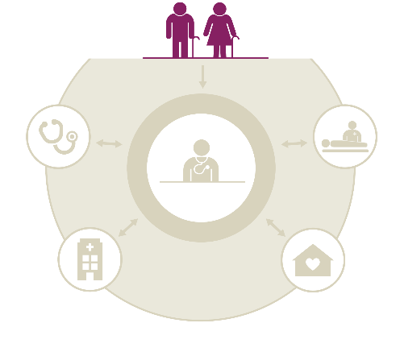
Health of Canadian seniors
Key findings
8 out of 10 Canadian seniors — a higher proportion than the international average — rate their health as excellent, very good or good.
However, many Canadian seniors face problems with their health and well-being, more so than seniors in other countries. A third live with at least 3 chronic conditions, 32% take 5 or more regular medications and 14% face a mental health problem such as depression or anxiety.
9% of Canadian seniors worry about not having enough money to buy nutritious meals or to pay for housing or other bills; this proportion is similar in other countries. 18% cannot pay for dental care, higher than the international average.
© 2018 Canadian Institute for Health Information

Slide 15
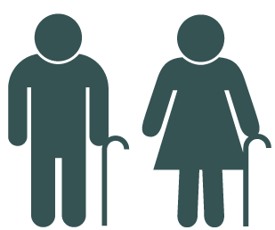
Canadian seniors have better self-perceived health than seniors in most other countries
Predictors of positive self-perceived health status include
Fewer chronic conditions
High level of confidence in managing health problems
Higher income
In the 2014 CMWF survey, older Canadians (age 55+) gave similar answers to the same question, and Canada’s placement among other countries was also similar.*
Above average
Same as average
Below average
© 2018 Canadian Institute for Health Information
Notes:
Source
* Canadian Institute for Health Information. How Canada Compares: Results From The Commonwealth Fund 2014 International Health Policy Survey of Older Adults. 2015. https://www.cihi.ca/en/commonwealth-fund-survey-2014.

Slide 16
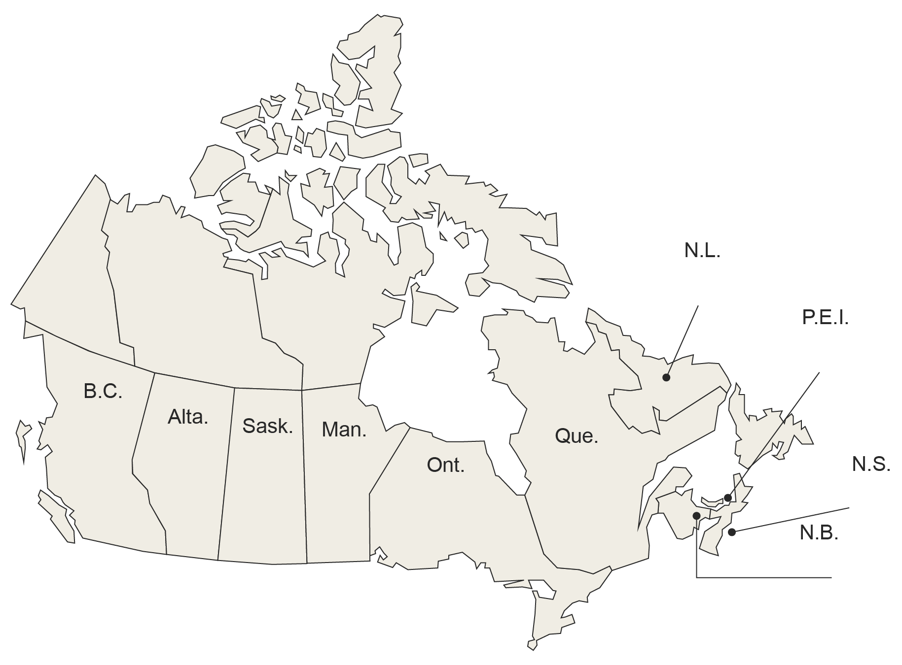
Provincial snapshot: Self-reported health excellent, very good or good
Canada
81%
CMWF
average
75%
80%
76%
84%
84%
83%
83%
80%
80%
82%
74%
Note
The Commonwealth Fund average was calculated by adding the results from the 11 countries and dividing by the number of countries. The Canadian average represents the average experience of Canadians (as opposed to the mean of provincial results).
Above average
Same as average
Below average
© 2018 Canadian Institute for Health Information

Slide 17
Canadian seniors have more chronic conditions than seniors in most other countries
Canadian median = 2 conditions
Those with 3+ chronic conditions
Saw more doctors
Had more hospital visits
Used the ED more
Had worse emotional health
Had worse self-rated health
* Hypertension or high blood pressure; heart disease, including heart attack; diabetes; asthma or chronic lung disease such as chronic bronchitis, emphysema or chronic obstructive pulmonary disease; depression, anxiety or other mental health problems; cancer; joint pain or arthritis; stroke.
Note
Totals may not add to 100% due to rounding.
© 2018 Canadian Institute for Health Information

Slide 18
More Canadian seniors take 5+ medications regularly than seniors in most other countries
Canadian median = 3 medications
Similar findings were seen in the Canadian Health Measures Survey, 2007 to 2011:*
Number of medications taken regularly | Percentage of seniors age 65 to 79
1 | 13
2–4 | 40
5+ | 30
Note
Totals may not add to 100% due to rounding.
© 2018 Canadian Institute for Health Information
Notes:
Source
* Rotermann M, et al.; Statistics Canada. Prescription medication use by Canadians aged 6 to 79. Accessed November 6, 2017. http://www.statcan.gc.ca/pub/82-003-x/2014006/article/14032-eng.htm.

Slide 19
Provincial snapshot: Chronic conditions
Percentage of respondents who | N.L. | P.E.I. | N.S. | N.B. | Que. | Ont. | Man. | Sask. | Alta. | B.C. | Can. | CMWF avg.
Had at least 1 chronic condition | 90 | 83 | 88 | 86 | 80 | 89 | 83 | 85 | 91 | 85 | 86 | 81
Had at least 3 chronic conditions | 48 | 35 | 46 | 36 | 26 | 36 | 25 | 36 | 33 | 37 | 33 | 27
Take at least 5 different prescription medications regularly | 40 | 29 | 31 | 39 | 36 | 33 | 24 | 33 | 32 | 20 | 32 | 26
Notes
The Commonwealth Fund average was calculated by adding the results from the 11 countries and dividing by the number of countries. The Canadian average represents the average experience of Canadians (as opposed to the mean of provincial results).
Above-average results are more desirable relative to the international average, while below-average results often indicate areas in need of improvement.
Above average
Same as average
Below average
© 2018 Canadian Institute for Health Information

Slide 20
More Canadian seniors have depression, anxiety or other mental health problems than seniors in many other countries
94% of those with depression, anxiety or other mental health problems also have other chronic medical conditions
Note
Above-average results are more desirable relative to the international average, while below-average results often indicate areas in need of improvement.
Above average
Same as average
Below average
© 2018 Canadian Institute for Health Information

Slide 21
Emotional well-being in Canadian seniors
Importance of social connectedness*
In 2016, 27% of the general population (age 18+) surveyed in Canada reported having experienced emotional distress.†
A senior’s social network can positively influence healthy behaviours, such as successful smoking cessation or remaining active
Social isolation is associated with higher levels of depression and suicide
© 2018 Canadian Institute for Health Information
Notes:
Sources
* Government of Canada. Report on the social isolation of seniors. Accessed November 6, 2017. https://www.canada.ca/en/national-seniors-council/programs/publications-reports/2014/social-isolation-seniors/page05.html.
† Canadian Institute for Health Information. How Canada Compares: Results From The Commonwealth Fund’s 2016 International Health Policy Survey of Adults in 11 Countries. 2017. https://www.cihi.ca/en/commonwealth-fund-survey-2016.

Slide 22
Provincial snapshot: Emotional health in seniors
Percentage of respondents who | N.L. | P.E.I. | N.S. | N.B. | Que. | Ont. | Man. | Sask. | Alta. | B.C. | Can. | CMWF avg.
Experienced depression | 14 | 16 | 15 | 17 | 13 | 15 | 13 | 11 | 17 | 15 | 14 | 12
Experienced emotional distress, such as anxiety or great sadness, which they found difficult to cope with by themselves in the past 2 years | 20 | 20 | 15 | 20 | 19 | 20 | 17 | 18 | 16 | 20 | 19 | 18
Felt isolated some of the time or often | 18 | 14 | 14 | 17 | 18 | 17 | 18 | 16 | 11 | 20 | 17 | 19
Notes
The Commonwealth Fund average was calculated by adding the results from the 11 countries and dividing by the number of countries. The Canadian average represents the average experience of Canadians (as opposed to the mean of provincial results).
Above-average results are more desirable relative to the international average, while below-average results often indicate areas in need of improvement.
Above average
Same as average
Below average
© 2018 Canadian Institute for Health Information

Slide 23
1 out of 5 Canadian seniors provided care to someone living with age- or health-related problems at least once a week
Many of the seniors who provide care to others have high needs themselves
2 out of 9 rated their health as fair or poor
3 out of 9 had at least 3 chronic conditions
3 out of 9 regularly used at least 5 prescription medications
1 out of 9 needed help with daily activities
2 out of 10 seniors who provided care to others received government help, such as occasional relief or respite care, financial support or tax credits to accommodate them in their caregiving duties
© 2018 Canadian Institute for Health Information

Slide 24
Income has an impact on the well-being of Canadian seniors
Health status
Distress
Isolation
Need help
Worried about money for
Meals
Rent
Other bills
9% of Canadian seniors were always or usually worried or stressed about having enough money, similar to the proportion in other countries
© 2018 Canadian Institute for Health Information

Slide 25
Provincial snapshot: Material hardship
Percentage of respondents who were always or usually worried or stressed about having enough money to | N.L. | P.E.I. | N.S. | N.B. | Que. | Ont. | Man. | Sask. | Alta. | B.C. | Can. | CMWF avg.
Buy nutritious meals | 6 | 5 | 7 | 2 | 4 | 5 | 6 | 4 | 6 | 7 | 5 | 5
Pay the rent or mortgage | 4 | 4 | 4 | 3 | 4 | 5 | 4 | 8 | 3 | 3 | 4 | 4
Pay other monthly bills | 6 | 6 | 9 | 4 | 4 | 6 | 4 | 7 | 5 | 4 | 5 | 5
Notes
The Commonwealth Fund average was calculated by adding the results from the 11 countries and dividing by the number of countries. The Canadian average represents the average experience of Canadians (as opposed to the mean of provincial results).
Above-average results are more desirable relative to the international average, while below-average results often indicate areas in need of improvement.
Above average
Same as average
Below average
© 2018 Canadian Institute for Health Information
Notes:
Note
Excludes respondents who answered “not applicable.”

Slide 26
Canadian seniors with low income face more cost barriers
Average spending in households headed by seniors*
Prescriptions
$646
Health care services
$273
Dental services
$417
© 2018 Canadian Institute for Health Information
Notes:
Source
* Statistics Canada. Survey of Household Spending, 2015. Accessed November 6, 2017. http://www.statcan.gc.ca/daily-quotidien/170127/dq170127a-eng.htm.

Slide 27
Provincial snapshot: Cost barriers to care in the past 12 months
Percentage of respondents who | N.L. | P.E.I. | N.S. | N.B. | Que. | Ont. | Man. | Sask. | Alta. | B.C. | Can. | CMWF avg.
Did not fill a prescription for medicine or skipped doses of their medicine because of the cost | 6 | 6 | 4 | 5 | 3 | 5 | 6 | 6 | 4 | 9 | 5 | 4
Had a medical problem but did not visit a doctor because of the cost | 2 | 1 | 2 | 5 | 3 | 3 | 3 | 3 | 3 | 3 | 3 | 4
Skipped a medical test, treatment or follow-up that was recommended by a doctor because of the cost | 2 | 3 | 3 | 4 | 5 | 3 | 5 | 5 | 2 | 5 | 4 | 5
Did not visit a dentist when they needed to because of the cost | 18 | 11 | 13 | 16 | 17 | 17 | 15 | 13 | 18 | 21 | 18 | 12
Notes
The Commonwealth Fund average was calculated by adding the results from the 11 countries and dividing by the number of countries. The Canadian average represents the average experience of Canadians (as opposed to the mean of provincial results).
Above-average results are more desirable relative to the international average, while below-average results often indicate areas in need of improvement.
Above average
Same as average
Below average
© 2018 Canadian Institute for Health Information
Notes:
Note
Excludes respondents who answered “not applicable.”

Slide 28
Very few Canadian seniors use wearable devices or digital technologies to monitor their health
Research from Diffusion of Smart Devices in Canada (2017):*
56% of seniors have heard of smart devices/wearables for health and well-being
Only 7% use one or more smart connected devices related to health and well-being
Note
Total does not add to 100% due to rounding.
© 2018 Canadian Institute for Health Information
Notes:
Source
* Paré G, et al. Diffusion of Smart Devices for Health in Canada. 2017. https://www.infoway-inforoute.ca/en/component/edocman/3366-the-diffusion-of-smart-devices-for-health-in-canada-study-final-report/view-document?Itemid=0.

Slide 29
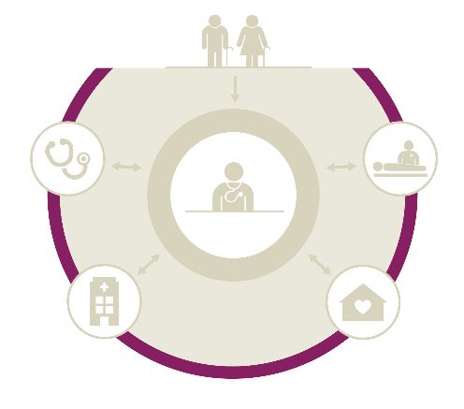
Perceived quality of health care
Key findings
Canada continues to perform below the international average (76%), with only two-thirds of Canadian seniors (67%) being satisfied with the overall quality of the health care they received; however, they report better experiences with their primary health care provider than the international average.
© 2018 Canadian Institute for Health Information

Slide 30
Fewer Canadian seniors were satisfied with the quality of the health care they received than seniors in other countries
Note
Above-average results are more desirable relative to the international average, while below-average results often indicate areas in need of improvement.
The opinions of older Canadians (age 55+) about their health systems haven’t changed since 2014†
Above average
Same as average
Below average
© 2018 Canadian Institute for Health Information
30
Notes:
Note
Excludes those who did not receive health care in the past year.
Sources
* Canadian Institute for Health Information. How Canada Compares: Results From The Commonwealth Fund’s 2016 International Health Policy Survey of Adults in 11 Countries. 2017. https://www.cihi.ca/en/commonwealth-fund-survey-2016.
† Canadian Institute for Health Information. How Canada Compares: Results From The Commonwealth Fund 2014 International Health Policy Survey of Older Adults. 2015. https://www.cihi.ca/en/commonwealth-fund-survey-2014.

Slide 31
Provincial snapshot: Seniors who are completely or very satisfied with the quality of health care they received in the past 12 months
Canada
67%
CMWF
average
76%
71%
69%
64%
71%
75%
61%
55%
73%
66%
69%
Notes
The Commonwealth Fund average was calculated by adding the results from the 11 countries and dividing by the number of countries. The Canadian average represents the average experience of Canadians (as opposed to the mean of provincial results).
Above-average results are more desirable relative to the international average, while below-average results often indicate areas in need of improvement.
Above average
Same as average
Below average
© 2018 Canadian Institute for Health Information
Notes:
Note
Excludes those who did not receive health care in the past year.

Slide 32
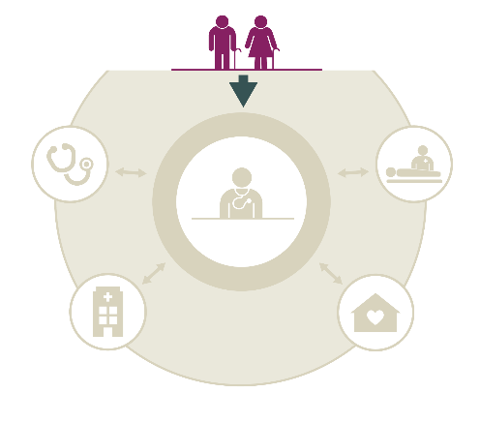
Access to primary health care
Key findings
Canada continues to perform below the international average for timely access to primary health care (44%), with almost two-thirds (59%) of seniors unable to get a same- or next-day appointment.
Close to two-thirds (62%) of Canadian seniors had difficulty getting medical care after hours without going to the hospital ED. Consequently, almost a third (31%) reported that the last time they went to the ED, it was for a condition that could have been treated by their regular doctor.
© 2018 Canadian Institute for Health Information

Slide 33
Access to primary health care in Canada is below CMWF average
Were able to get a same- or next-day appointment*
Thought it was very or somewhat easy to get medical care after hours without going to the emergency department†
Always or often received a same-day response for a medical concern from their regular doctor‡
Canada
In the 2014§ (age 55+) and 2016** (age 18+) CMWF surveys, Canadians reported similar results for accessing their primary care provider. Canada’s place among other countries was similar in both years.
1 out of 8 Canadian seniors waited at least 2 weeks to see their regular doctor
Above average
Same as average
Below average
© 2018 Canadian Institute for Health Information
Notes:
Notes
* Excludes respondents who did not seek a medical appointment.
† Excludes respondents who never needed care evenings, weekends or holidays.
‡ Excludes respondents who never tried to contact their doctor.
Sources
§ Canadian Institute for Health Information. How Canada Compares: Results From The Commonwealth Fund 2014 International Health Policy Survey of Older Adults. 2015. https://www.cihi.ca/en/commonwealth-fund-survey-2014.
** Canadian Institute for Health Information. How Canada Compares: Results From The Commonwealth Fund’s 2016 International Health Policy Survey of Adults in 11 Countries. 2017. https://www.cihi.ca/en/commonwealth-fund-survey-2016.

Slide 34
Provincial snapshot: Access to primary health care
Percentage of respondents who | N.L. | P.E.I. | N.S. | N.B. | Que. | Ont. | Man. | Sask. | Alta. | B.C. | Can. | CMWF avg.
Were able to get an appointment to see a doctor or a nurse the same or next day the last time they were sick or needed medical attention* | 36 | 36 | 35 | 37 | 32 | 47 | 40 | 44 | 42 | 46 | 41 | 56
Thought it was very or somewhat easy to get medical care evenings, weekends or holidays without going to the hospital ED† | 24 | 22 | 31 | 42 | 34 | 41 | 24 | 43 | 49 | 37 | 38 | 51
Always or often got an answer the same day when they contacted their regular doctor’s office with a medical concern during regular practice hours‡ | 75 | 71 | 71 | 69 | 67 | 78 | 72 | 74 | 74 | 70 | 73 | 84
Note
The Commonwealth Fund average was calculated by adding the results from the 11 countries and dividing by the number of countries. The Canadian average represents the average experience of Canadians (as opposed to the mean of provincial results).
Above average
Same as average
Below average
© 2018 Canadian Institute for Health Information
Notes:
Notes
* Excludes respondents who did not seek a medical appointment. This information was not available in earlier years.
† Excludes respondents who never needed care evenings, weekends or holidays.
‡ Excludes respondents who never tried to contact their doctor.

Slide 35
Canada is closer to the international average for seniors’ ED use for conditions that could have been treated by their regular doctor
Note
Above-average results are more desirable relative to the international average, while below-average results often indicate areas in need of improvement.
Above average
Same as average
Below average
© 2018 Canadian Institute for Health Information

Slide 36
Provincial snapshot: Seniors’ ED use for conditions that could have been treated by their regular physician
Did you know?
Canada
The Atlantic provinces have higher proportions of the population living in rural areas than other provinces.* In rural Canada, the ED may be the only place to receive treatments that are performed in family practice settings in urban areas.†
31%
CMWF
average
28%
45%
45%
31%
26%
24%
34%
29%
32%
41%
44%
Notes
The Commonwealth Fund average was calculated by adding the results from the 11 countries and dividing by the number of countries. The Canadian average represents the average experience of Canadians (as opposed to the mean of provincial results).
Above-average results are more desirable relative to the international average, while below-average results often indicate areas in need of improvement.
Above average
Same as average
Below average
© 2018 Canadian Institute for Health Information
Notes:
Sources
* Statistics Canada. Figure 3: Proportion of the population living in rural areas, provinces and territories, 2006 and 2011. Accessed November 6, 2017. http://www12.statcan.gc.ca/census-recensement/2011/as-sa/98-310-x/2011003/fig/fig3_2-3-eng.cfm.
† Canadian Institute for Health Information. Sources of Potentially Avoidable Emergency Department Visits. 2014. https://secure.cihi.ca/estore/productFamily.htm?locale=en&pf=PFC2708.

Slide 37
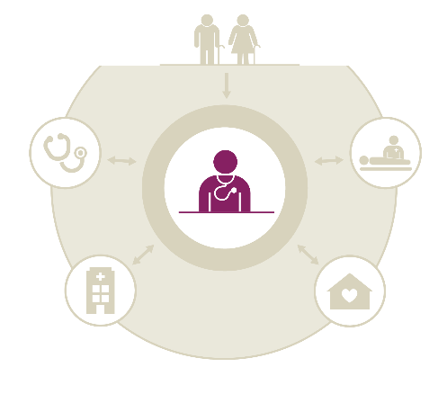
Primary health care
Key findings
Generally, Canadians report better experiences with their primary health care provider than the international average, with respect to their regular doctor knowing their medical history, involving them in medical decisions, spending enough time with them and encouraging them to ask questions.
When it comes to managing the complex medical needs of seniors, the majority of Canadian seniors (82%) — more than the international average — had a medication review within the past 12 months as well as a treatment plan for their chronic conditions.
Only 65% have a health care professional they can easily contact to ask a question between doctor visits, and even fewer (14%) have a health care professional contacting them between doctor visits; both of these proportions are below the international average.
While better than the international average, 59% of Canadian seniors are not very confident in managing their own health problems.
Canadian seniors are more likely to discuss healthy lifestyle choices with their care providers, but gaps remain. For instance, close to half did not discuss a healthy diet or exercise.
© 2018 Canadian Institute for Health Information

Slide 38
Almost all Canadian seniors have a regular doctor or place of care, and report better experiences with their regular doctors than CMWF average
Percentage of respondents who said that their regular doctor or medical staff always
Knows important information about their medical history
Spends enough time with them
Encourages them to ask questions
Explains things in a way that is easy to understand
Involves them as much as they want in decisions about their treatment or care
Canada
Canadians’ experience with regular doctors remains better than the international average, as was also seen in the 2014* (age 55+) and 2016† (age 18+) surveys.
Above average
Same as average
Below average
© 2018 Canadian Institute for Health Information
Notes:
Note
Excludes respondents who answered “not applicable.”
Sources
* Canadian Institute for Health Information. How Canada Compares: Results From The Commonwealth Fund 2014 International Health Policy Survey of Older Adults. 2015. https://www.cihi.ca/en/commonwealth-fund-survey-2014.
† Canadian Institute for Health Information. How Canada Compares: Results From The Commonwealth Fund’s 2016 International Health Policy Survey of Adults in 11 Countries. 2017. https://www.cihi.ca/en/commonwealth-fund-survey-2016.

Slide 39
Provincial snapshot: Patient experience with regular doctor
Percentage of respondents who said that their regular doctor or medical staff always | N.L. | P.E.I. | N.S. | N.B. | Que. | Ont. | Man. | Sask. | Alta. | B.C. | Can. | CMWF avg.
Knows important information about their medical history | 68 | 69 | 74 | 70 | 75 | 72 | 62 | 68 | 76 | 67 | 72 | 66
Spends enough time with them | 64 | 61 | 66 | 62 | 69 | 66 | 59 | 66 | 65 | 59 | 65 | 61
Encourages them to ask questions | 43 | 51 | 53 | 51 | 57 | 56 | 47 | 49 | 52 | 50 | 54 | 46
Explains things in a way that is easy to understand | 65 | 75 | 75 | 67 | 78 | 74 | 69 | 73 | 77 | 69 | 74 | 69
Involves them as much as they want in decisions about their treatment or care | 65 | 63 | 69 | 64 | 64 | 69 | 61 | 69 | 76 | 64 | 67 | 61
Note
The Commonwealth Fund average was calculated by adding the results from the 11 countries and dividing by the number of countries. The Canadian average represents the average experience of Canadians (as opposed to the mean of provincial results).
Above average
Same as average
Below average
© 2018 Canadian Institute for Health Information
Notes:
Note
Excludes respondents who answered “not applicable.”

Slide 40
Canadian seniors are more likely to discuss healthy lifestyle choices, but more could be done
Percentage of respondents who, in the past 2 years, talked to their doctor or other clinical staff at their regular place of care about
A healthy diet and healthy eating
Exercise or physical activity
Alcohol use
Things in their life that worry them or cause stress
Canada
Above average
Same as average
Below average
© 2018 Canadian Institute for Health Information
Notes:
Note
Excludes respondents who had not seen a doctor in the past 2 years.

Slide 41
Provincial snapshot: Healthy lifestyle discussions as part of regular care with family doctor
Percentage of respondents who, in the past 2 years, talked to their doctor or other clinical staff at their regular place of care about | N.L. | P.E.I. | N.S. | N.B. | Que. | Ont. | Man. | Sask. | Alta. | B.C. | Can. | CMWF avg.
A healthy diet and healthy eating | 38 | 40 | 53 | 43 | 43 | 47 | 44 | 45 | 50 | 40 | 45 | 42
Exercise or physical activity | 41 | 48 | 53 | 45 | 48 | 55 | 56 | 51 | 55 | 53 | 52 | 50
Alcohol use | 7 | 12 | 10 | 11 | 22 | 15 | 17 | 12 | 21 | 16 | 17 | 18
Things in their life that worry them or cause stress | 12 | 19 | 19 | 20 | 20 | 22 | 18 | 16 | 23 | 20 | 21 | 20
Note
The Commonwealth Fund average was calculated by adding the results from the 11 countries and dividing by the number of countries. The Canadian average represents the average experience of Canadians (as opposed to the mean of provincial results).
Above average
Same as average
Below average
© 2018 Canadian Institute for Health Information
Notes:
Note
Excludes respondents who had not seen a doctor in the past 2 years.

Slide 42
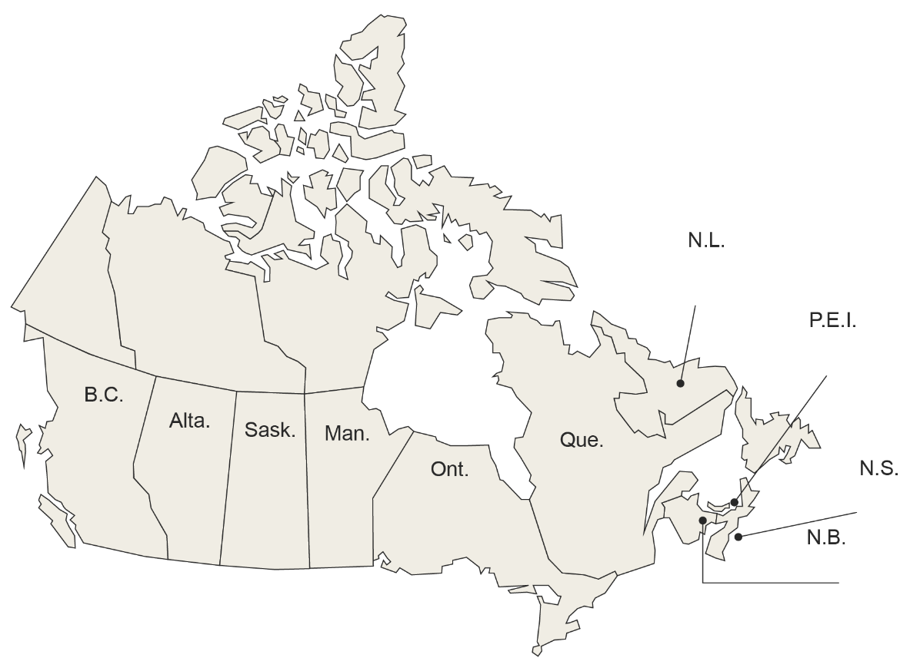
4 out of 5 Canadian seniors with 2+ medications had a medication review
56%
76%
78%
86%
75%
79%
82%
84%
78%
71%
Note
The Commonwealth Fund average was calculated by adding the results from the 11 countries and dividing by the number of countries. The Canadian average represents the average experience of Canadians (as opposed to the mean of provincial results).
Above average
Same as average
Below average
© 2018 Canadian Institute for Health Information

Slide 43
Only 4 out of 10 Canadian seniors who have a chronic condition are very confident in managing their health problems
Percentage of respondents who
Are very confident in their ability to control and manage their health problems
Discussed their goals and care priorities with a health care professional
Received clear instructions about symptoms to watch for and when to seek further care or treatment
Have a treatment plan to carry out in their daily lives
Have a health care professional contacting them between doctor visits
Have a health care professional who they can easily contact to ask a question between doctor visits
Canada
Above average
Same as average
Below average
© 2018 Canadian Institute for Health Information
Notes:
Note
There is a slight methodological difference in the 2017 results due to updates in question design and a new exclusion of respondents who were no longer receiving treatment.

Slide 44
Provincial snapshot: Chronic condition management
Percentage of respondents who | N.L. | P.E.I. | N.S. | N.B. | Que. | Ont. | Man. | Sask. | Alta. | B.C. | Can. | CMWF avg.
Are very confident in their ability to control and manage their health problems | 45 | 37 | 47 | 40 | 23 | 47 | 36 | 40 | 50 | 42 | 41 | 35
Discussed their goals and care priorities with a health care professional | 59 | 58 | 69 | 63 | 62 | 61 | 56 | 67 | 68 | 67 | 63 | 60
Received clear instructions about symptoms to watch for and when to seek further care or treatment | 52 | 60 | 65 | 60 | 60 | 60 | 50 | 59 | 58 | 60 | 59 | 59
Have a treatment plan for their chronic condition that they can carry out in their daily lives | 84 | 78 | 85 | 86 | 70 | 82 | 83 | 81 | 84 | 84 | 80 | 67
Have a health care professional contacting them to see how things are going between doctor visits | 9 | 11 | 12 | 18 | 14 | 15 | 7 | 10 | 16 | 13 | 14 | 19
Have a health care professional who they can easily contact to ask a question or get advice about their health condition(s) between doctor visits | 62 | 65 | 67 | 70 | 59 | 66 | 59 | 62 | 76 | 65 | 65 | 67
Note The Commonwealth Fund average was calculated by adding the results from the 11 countries and dividing by the number of countries. The Canadian average represents the average experience of Canadians (as opposed to the mean of provincial results).
Above average
Same as average
Below average
© 2018 Canadian Institute for Health Information
Notes:
Note
There is a slight methodological difference in the 2017 results due to updates in question design and a new exclusion of respondents who were no longer receiving treatment.

Slide 45
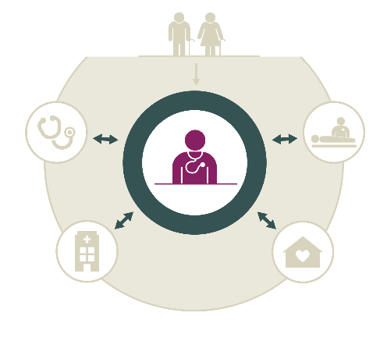
Coordination
Key findings
Well-coordinated care is especially important for seniors. 1 out of 7 seniors saw at least 4 doctors in the previous 12 months. Primary health care providers play an essential role in both providing and coordinating care. 82% of Canadian seniors said their regular doctor helps coordinate care from other places, which is above the international average.
Some Canadian seniors face coordination problems. 12% said medical test results were unavailable at their appointment, 11% had received conflicting information from different health care providers and 8% thought a medical mistake had been made in their treatment or care. For the most part, these results are similar to the international average.
© 2018 Canadian Institute for Health Information

Slide 46
15% of Canadian seniors saw 4+ doctors in the past 12 months (excluding hospitalizations)
Canadians rely more on doctors to provide care compared with other countries.* Seniors in other countries, such as the Netherlands and Sweden, may need to see fewer doctors due to more interprofessional collaboration involving nurses in primary health care delivery.†, ‡
Note
Totals may not add to 100% due to rounding.
© 2018 Canadian Institute for Health Information
Notes:
Sources
* Canadian Institute for Health Information. How Canada Compares: Results From The Commonwealth Fund’s 2016 International Health Policy Survey of Adults in 11 Countries. 2017. https://www.cihi.ca/en/commonwealth-fund-survey-2016.
† EvidenceNetwork.ca. Backgrounder: The Dutch health care system. Accessed October 1, 2017. http://evidencenetwork.ca/archives/20621.
‡ European Forum for Primary Care. Primary care in Sweden. Accessed November 6, 2017. http://www.euprimarycare.org/column/primary-care-sweden.

Slide 47
Most Canadian seniors always or often received help from their regular doctor’s office to coordinate care
Of the 18% whose doctor’s office sometimes, rarely or never helped coordinate care, 31% needed help in coordinating care or treatment they received from different health care professionals
Above average
Same as average
Below average
© 2018 Canadian Institute for Health Information
Notes:
Note
There is a slight methodological difference in the 2017 result, as it excludes respondents who never needed coordination.

Slide 48
Provincial snapshot: Care coordination by regular doctor
Percentage of respondents who | N.L. | P.E.I. | N.S. | N.B. | Que. | Ont. | Man. | Sask. | Alta. | B.C. | Can. | CMWF avg.
Saw 4 or more different doctors in the past 12 months, not counting any time they may have been hospitalized | 14 | 11 | 11 | 17 | 13 | 17 | 13 | 13 | 13 | 15 | 15 | 15
Reported that their regular doctor or someone in their doctor’s practice always or often helps coordinate or arrange the care they receive from other doctors and places* | 79 | 83 | 87 | 84 | 75 | 86 | 74 | 84 | 85 | 78 | 82 | 77
Note
The Commonwealth Fund average was calculated by adding the results from the 11 countries and dividing by the number of countries. The Canadian average represents the average experience of Canadians (as opposed to the mean of provincial results).
Above average
Same as average
Below average
© 2018 Canadian Institute for Health Information
Notes:
Note
* Excludes respondents who never needed coordination.

Slide 49
Care coordination in Canada is similar to the CMWF average
Whose test results or medical records were not available at the time of their scheduled medical care appointment
Who received conflicting information from different doctors or health care professionals
Whose doctors ordered a medical test that they felt was unnecessary because the test had already been done
Who thought a medical mistake had been made in their treatment or care
Canada
Note
Above-average results are more desirable relative to the international average, while below-average results often indicate areas in need of improvement.
Above average
Same as average
Below average
© 2018 Canadian Institute for Health Information
Notes:
Note
Excludes respondents who answered “not applicable.”

Slide 50
Provincial snapshot: Care coordination
Percentage of respondents | N.L. | P.E.I. | N.S. | N.B. | Que. | Ont. | Man. | Sask. | Alta. | B.C. | Can. | CMWF avg.
Whose test results or medical records were not available at the time of their scheduled medical care appointment | 9 | 11 | 4 | 12 | 11 | 11 | 10 | 10 | 13 | 15 | 12 | 10
Who received conflicting information from different doctors or health care professionals | 10 | 10 | 7 | 12 | 10 | 12 | 10 | 12 | 11 | 13 | 11 | 11
Whose doctors ordered a medical test that they felt was unnecessary because the test had already been done | 8 | 3 | 4 | 6 | 6 | 7 | 8 | 8 | 7 | 8 | 7 | 7
Who thought a medical mistake had been made in their treatment or care | 7 | 7 | 8 | 8 | 8 | 7 | 8 | 8 | 10 | 11 | 8 | 9
Notes
The Commonwealth Fund average was calculated by adding the results from the 11 countries and dividing by the number of countries. The Canadian average represents the average experience of Canadians (as opposed to the mean of provincial results).
Above-average results are more desirable relative to the international average, while below-average results often indicate areas in need of improvement.
Above average
Same as average
Below average
© 2018 Canadian Institute for Health Information
Notes:
Note
Excludes respondents who answered “not applicable.”

Slide 51
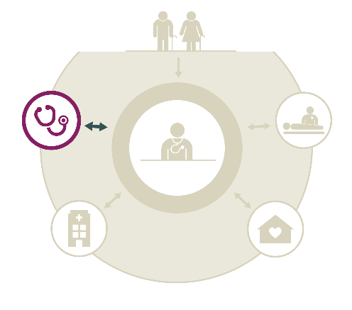
Specialist care and coordination with primary health care
Key findings
Results suggest that access to and coordination of specialist care could be improved. Canadian seniors had the longest wait times for specialists, with 3 out of 5 waiting at least 4 weeks for an appointment.
As well, 5% of seniors said their specialist did not have basic medical information from their regular doctor, while 13% said their regular doctor did not seem informed about the specialist care they’d received. Both results are close to the international average.
© 2018 Canadian Institute for Health Information

Slide 52
3 out of 5 Canadian seniors needed to see or had seen a specialist in the past 2 years
61%
53%
62%
60%
56%
58%
57%
66%
59%
55%
Note
The Commonwealth Fund average was calculated by adding the results from the 11 countries and dividing by the number of countries. The Canadian average represents the average experience of Canadians (as opposed to the mean of provincial results).
Above average
Same as average
Below average
© 2018 Canadian Institute for Health Information

Slide 53
Wait times for specialists growing longer in Canada
Seniors who waited at least 4 weeks to see a specialist in the past 2 years
Note
Above-average results are more desirable relative to the international average, while below-average results often indicate areas in need of improvement.
1 out of 4 Canadian seniors waited at least 2 months to see a specialist in 2017
Above average
Same as average
Below average
© 2018 Canadian Institute for Health Information
Notes:
Note
Excludes respondents who never tried to get an appointment.

Slide 54
Two-way communication between specialists and regular doctors is now similar to CMWF average
Note
Above-average results are more desirable relative to the international average, while below-average results often indicate areas in need of improvement.
In 2014, 13% of Canadian older adults (age 55+) reported that specialists did not have information from their regular doctor (higher than CMWF average of 9%) and 25% reported that their regular doctor did not have information from specialists (higher than CMWF average of 18%).*
Above average
Same as average
Below average
© 2018 Canadian Institute for Health Information
Notes:
Note
Excludes respondents who never saw a specialist and those who had not seen a regular doctor or GP since seeing the specialist.
Source
* Canadian Institute for Health Information. How Canada Compares: Results From The Commonwealth Fund 2014 International Health Policy Survey of Older Adults. 2015. https://www.cihi.ca/en/commonwealth-fund-survey-2014.

Slide 55
Provincial snapshot: Specialist care and coordination with primary health care
Percentage of respondents who | N.L. | P.E.I. | N.S. | N.B. | Que. | Ont. | Man. | Sask. | Alta. | B.C. | Can. | CMWF avg.
Waited for 4 weeks or more for a specialist appointment after being advised to see one* | 65 | 60 | 56 | 60 | 61 | 55 | 59 | 68 | 64 | 61 | 59 | 41
Said their specialist did not have basic medical information or test results from their regular doctor about the reason for their visit† | 8 | 5 | 4 | 3 | 6 | 4 | 5 | 6 | 4 | 7 | 5 | 6
Said their regular doctor did not seem informed and up to date about the care they got from the specialist after they saw the specialist† | 11 | 10 | 6 | 21 | 15 | 11 | 17 | 17 | 12 | 12 | 13 | 14
Notes
The Commonwealth Fund average was calculated by adding the results from the 11 countries and dividing by the number of countries. The Canadian average represents the average experience of Canadians (as opposed to the mean of provincial results).
Above-average results are more desirable relative to the international average, while below-average results often indicate areas in need of improvement.
Above average
Same as average
Below average
© 2018 Canadian Institute for Health Information
Notes:
Notes
* Excludes respondents who never tried to get an appointment.
† Excludes respondents who never saw a specialist and those who had not seen a regular doctor or GP since seeing the specialist.

Slide 56
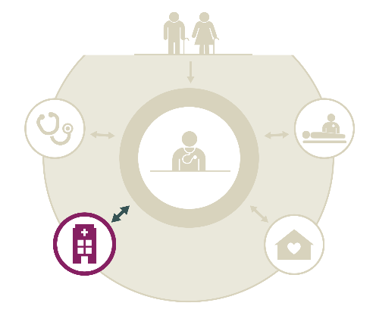
Hospital care and coordination
Key findings
Although Canada’s results are very similar to the international average, gaps remain in communication and hospital discharge planning for seniors. 1 out of 5 did not receive written information on what to do after discharge or did not have follow-up care arranged. One-quarter of seniors (27%) did not have someone review the purpose of each of their medications with them.
1 out of 10 Canadian seniors said that their regular doctor did not seem informed about their hospital care.
© 2018 Canadian Institute for Health Information

Slide 57
More Canadian seniors used the ED but fewer stayed in the hospital compared with CMWF average
Note
Above-average results are more desirable relative to the international average, while below-average results often indicate areas in need of improvement.
Above average
Same as average
Below average
© 2018 Canadian Institute for Health Information

Slide 58
Provincial snapshot: Hospital use
Percentage of respondents who had | N.L. | P.E.I. | N.S. | N.B. | Que. | Ont. | Man. | Sask. | Alta. | B.C. | Can. | CMWF avg.
Used a hospital ED for their own medical care in the past 2 years | 47 | 44 | 47 | 44 | 35 | 39 | 37 | 37 | 38 | 39 | 38 | 31
Been admitted to the hospital for an overnight stay in the past 2 years | 21 | 19 | 22 | 22 | 24 | 21 | 24 | 24 | 23 | 23 | 22 | 28
Notes
The Commonwealth Fund average was calculated by adding the results from the 11 countries and dividing by the number of countries. The Canadian average represents the average experience of Canadians (as opposed to the mean of provincial results).
Above-average results are more desirable relative to the international average, while below-average results often indicate areas in need of improvement.
Above average
Same as average
Below average
© 2018 Canadian Institute for Health Information

Slide 59
89% of Canadian seniors who were hospitalized felt they had the support and services they needed to help them manage their health condition at home
Factors that contributed to these patients feeling well supported
Having arrangements for follow-up care with a health care professional
Having someone discuss the purpose of each medication
Knowing who to contact for questions about their condition
Above average
Same as average
Below average
© 2018 Canadian Institute for Health Information
Notes:
Note
Excludes respondents who did not need support to manage their health after discharge.

Slide 60
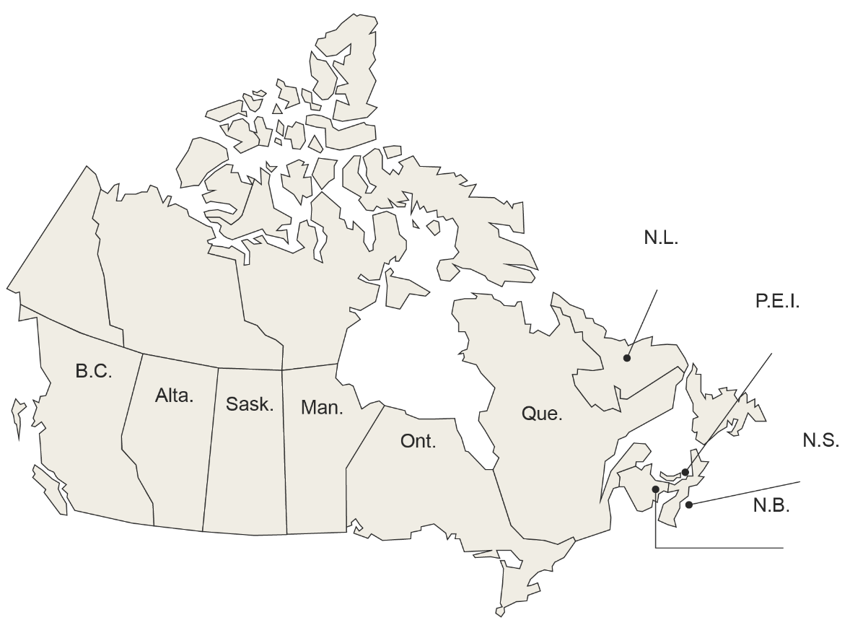
1 out of 10 Canadian seniors said their regular doctor/clinic did not seem informed about their hospital care after discharge
7%
5%
3%
5%
19%
23%
16%
12%
8%
7%
Notes
The Commonwealth Fund average was calculated by adding the results from the 11 countries and dividing by the number of countries. The Canadian average represents the average experience of Canadians (as opposed to the mean of provincial results).
Above-average results are more desirable relative to the international average, while below-average results often indicate areas in need of improvement.
Above average
Same as average
Below average
© 2018 Canadian Institute for Health Information
Notes:
Did you know?
In New Zealand, primary health care providers can receive electronic hospital discharge summaries directly. This may contribute to the reason very few seniors in New Zealand said that their regular doctor was not informed about their hospital care.*
Note
Excludes respondents who did not see their doctor after leaving the hospital.
Source
* International Health Care System Profiles. The New Zealand health care system. Accessed October 1, 2017. http://international.commonwealthfund.org/countries/new_zealand/.

Slide 61
Some seniors who had a hospital stay did not receive comprehensive discharge planning
Who did not receive written information on what to do when they returned home and what symptoms to watch for
Whose hospital did not make arrangements for or make sure they had follow-up care with a doctor or other health care professional*
Who did not have someone discuss with them the purpose of taking each of their medications†
Who did not know who to contact if they had a question about their condition or treatment
Canada
Above average
Same as average
Below average
© 2018 Canadian Institute for Health Information
Notes:
Notes
* Excludes respondents who did not need follow-up care.
† Excludes respondents who did not need to take any medications.

Slide 62
Provincial snapshot: Discharge planning
Percentage of respondents | N.L. | P.E.I. | N.S. | N.B. | Que. | Ont. | Man. | Sask. | Alta. | B.C. | Can. | CMWF avg.
Who felt they had the support and services they needed to help them manage their health condition at home after discharge* | 87 | 96 | 88 | 96 | 87 | 89 | 80 | 88 | 97 | 90 | 89 | 88
Who received written information on what to do when they returned home and what symptoms to watch for when they left the hospital | 75 | 69 | 67 | 82 | 70 | 86 | 79 | 75 | 81 | 78 | 79 | 76
Whose hospital made arrangements for or made sure they had follow-up care with a doctor or other health care professional when they left the hospital† | 83 | 83 | 85 | 82 | 72 | 84 | 71 | 74 | 95 | 75 | 80 | 79
Who had someone discuss with them the purpose of taking each of their medications when they left the hospital‡ | 80 | 70 | 72 | 77 | 66 | 74 | 74 | 67 | 76 | 81 | 73 | 71
Who knew who to contact if they had a question about their condition or treatment after they left the hospital | 91 | 96 | 86 | 93 | 85 | 90 | 82 | 95 | 98 | 97 | 90 | 88
Note
The Commonwealth Fund average was calculated by adding the results from the 11 countries and dividing by the number of countries. The Canadian average represents the average experience of Canadians (as opposed to the mean of provincial results).
Above average
Same as average
Below average
© 2018 Canadian Institute for Health Information
Notes:
Notes
* Excludes respondents who did not need support to manage their health after discharge.
† Excludes respondents who did not need follow-up care.
‡ Excludes respondents who did not need to take any medications.

Slide 63
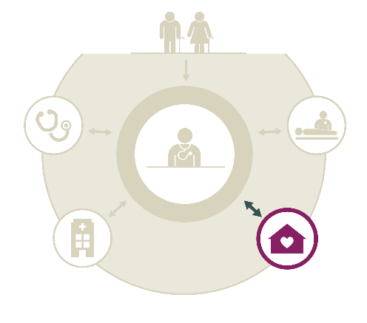
Home care
Key findings
11% of Canadian seniors had help with certain activities of daily living; most of them (4 out of 5) received it from a family member or friend.
1% of Canadian seniors reported needing help with activities of daily living but not receiving it.
6% of Canadian seniors received publicly funded home care services. The majority were satisfied with the services received and with the coordination between their home care provider and their regular health care professional. They felt these services helped them stay at home.
3% of Canadian seniors felt they needed publicly funded home care services but did not receive them.
© 2018 Canadian Institute for Health Information

Slide 64
11% of Canadian seniors received help with certain activities of daily living
Those who received help with certain activities of daily living (housework, preparing meals, managing daily medications or shopping) received it from
Family members or friends
Both family or friends and health professionals
Aide, nurse or other health professional
Religious or charitable organization
Note
Multiple responses were allowed, so the sum of responses does not total 100%.
© 2018 Canadian Institute for Health Information

Slide 65
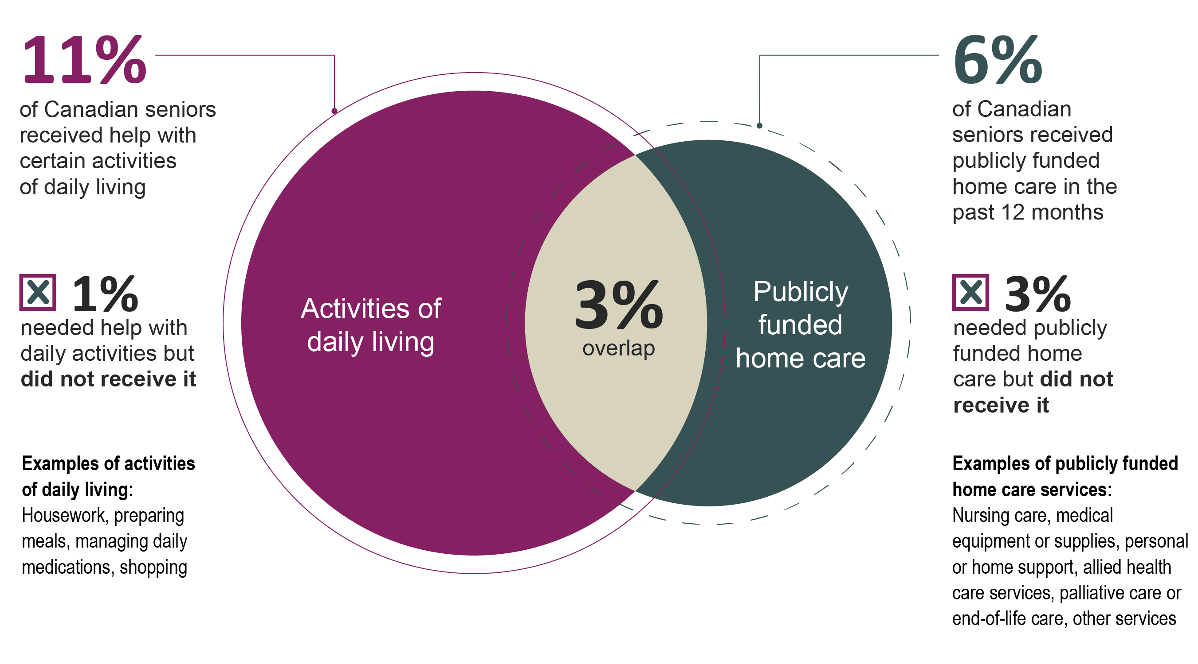
Canadian seniors received various types of help
Note
In addition to the 6% who received publicly funded home care services for themselves, 4% of respondents said that someone else (of any age) in their household was receiving publicly funded home care services.
© 2018 Canadian Institute for Health Information

Slide 66
6% of seniors surveyed received publicly funded home care services
54% of home care service recipients started receiving services after a hospital visit
Notes
In addition to the 6% who received publicly funded home care services for themselves, 4% of respondents said that someone else (of any age) in their household was receiving publicly funded home care services.
Provincial-level analyses were not performed due to small sample sizes.
© 2018 Canadian Institute for Health Information
Notes:
Note
* Only respondents who answered that they are receiving home care services themselves or that they and someone else in their household are receiving home care services are included in the “receiving home care services” category. Respondents who answered that no one in their household is receiving home care services are included in the “not receiving home care services” category.

Slide 67
Canadian seniors received a variety of publicly funded home care services
Publicly funded home care services received include
Nursing care (e.g., bandage changes, preparing medications, a check-up from a nurse)
Medical equipment or supplies (e.g., wheelchair, pads for incontinence, help with using a ventilator or oxygen equipment)
Personal or home support such as help with bathing, housekeeping or meal preparation
Other health care services such as physiotherapy, occupational therapy, speech therapy and nutrition counselling
Any other services
Palliative care or end-of-life care
Notes
Multiple responses were allowed, so the sum of responses does not total 100%.
Provincial-level analyses were not performed for publicly funded home care services due to small sample sizes.
© 2018 Canadian Institute for Health Information
Notes:
Note
The following groups of respondents were included in this analysis:
Those who are receiving home care services themselves, and those who answered that they and someone else in their household are receiving home care services.
Those who reside in a seniors-only household, for those who answered that someone else in their household is receiving home care services.

Slide 68
Most publicly funded home care recipients were satisfied with the services received
86% of those who received home care (for themselves or someone in their household) said that the services helped the recipient stay at home
Note
Provincial-level analyses were not performed for publicly funded home care services due to small sample sizes.
© 2018 Canadian Institute for Health Information
Notes:
Note
The following groups of respondents were included in this analysis:
Those who are receiving home care services themselves, and those who answered that they and someone else in their household are receiving home care services.
Those who reside in a seniors-only household, for those who answered that someone else in their household is receiving home care services.

Slide 69
Most home care recipients were satisfied with the coordination between the home care provider and their regular health care provider
Better Home Care in Canada: A National Action Plan
One of the goals identified was to accelerate the adoption of technology in the home care sector to ensure that everyone involved can easily access and share relevant health information and the care plan*
Note
Provincial-level analyses were not performed for publicly funded home care services due to small sample sizes.
© 2018 Canadian Institute for Health Information
Notes:
Note
The following groups of respondents were included in this analysis:
Those who are receiving home care services themselves, and those who answered that they and someone else in their household are receiving home care services.
Those who reside in a seniors-only household, for those who answered that someone else in their household is receiving home care services.
Source
* Canadian Home Care Association, Canadian Nurses Association, College of Family Physicians of Canada. Better Home Care in Canada: A National Action Plan. 2016. http://www.thehomecareplan.ca/wp-content/uploads/2016/10/Better-Home-Care-Report-Oct-web.pdf.

Slide 70
3% of Canadian seniors felt they needed publicly funded home care services but did not receive them
Unknown reason
Not eligible for home care
Too expensive
Services were not available in their area
Did not know where to go
Wait times were too long
Inconvenient hours
Personal or home support
Other health care services such as physiotherapy, occupational therapy, speech therapy and nutrition counselling
Nursing care
Medical equipment or supplies
Any other services
Palliative
Notes
3% represents 135 people. Given the small sample size, please exercise caution in interpreting results.
Multiple responses were allowed, so the sum of responses does not total 100%.
© 2018 Canadian Institute for Health Information

Slide 71
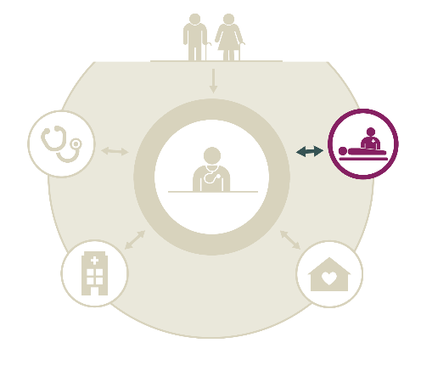
End-of-life planning and medical assistance in dying
Key findings
More Canadian seniors have engaged in end-of-life care planning than seniors in other countries. Approximately two-thirds have discussed their end-of-life care wishes with someone (66%) and have documented a substitute decision-maker (63%). In contrast, less than half (44%) have a written plan or document describing their end-of-life care wishes.
For the first time, survey respondents were asked about medical assistance in dying (MAID). 12% of Canadian seniors or a family member have talked to a health care provider about access to MAID, and 64% are confident or very confident that they would be able to obtain MAID in their community if they were eligible and wished to receive it.
© 2018 Canadian Institute for Health Information

Slide 72
More Canadian seniors have engaged in end-of-life care planning than seniors in other countries
Have had a discussion with family, friends or health care professionals about their end-of-life wishes
Have a written plan or document describing their end-of-life wishes
Have a written document that names someone to make treatment decisions for them if they cannot make decisions for themselves
Canada
Above average
Same as average
Below average
© 2018 Canadian Institute for Health Information

Slide 73
Provincial snapshot: End-of-life care planning
Percentage of respondents who | N.L. | P.E.I. | N.S. | N.B. | Que. | Ont. | Man. | Sask. | Alta. | B.C. | Can. | CMWF avg.
Have had a discussion with family, a close friend or a health care professional about the health care treatment they want or do not want in the event that they cannot make decisions for themselves | 50 | 59 | 69 | 61 | 64 | 70 | 71 | 67 | 68 | 59 | 66 | 49
Have a written plan or document describing the health care treatment they want or do not want at the end of their lives | 23 | 32 | 33 | 36 | 43 | 48 | 44 | 39 | 51 | 38 | 44 | 28
Have a written document naming someone to make treatment decisions for them if they cannot make decisions for themselves | 43 | 52 | 51 | 53 | 64 | 71 | 62 | 52 | 61 | 54 | 63 | 36
Note
The Commonwealth Fund average was calculated by adding the results from the 11 countries and dividing by the number of countries. The Canadian average represents the average experience of Canadians (as opposed to the mean of provincial results).
Above average
Same as average
Below average
© 2018 Canadian Institute for Health Information

Slide 74
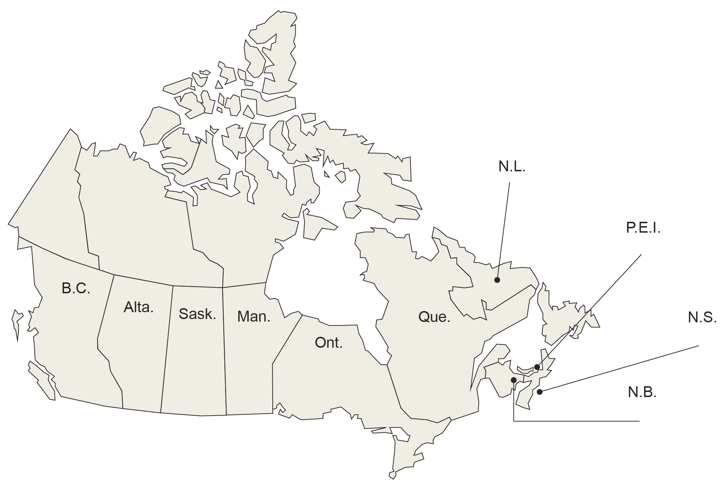
Medical assistance in dying
Canada
Canadian seniors or a family member have talked to a health care provider about access to medical assistance in dying*
Are confident or very confident that they would be able to obtain medical assistance in dying in their community if they were eligible and wished to receive it†
12%
64%
10%
71%
9%
8%
66%
10%
8%
12%
18%
10%
66%
10%
71%
68%
63%
55%
56%
67%
12%
65%
Note
The Canadian average represents the average experience of Canadians (as opposed to the mean of provincial results).
© 2018 Canadian Institute for Health Information
Notes:
Notes
* Excludes those who said that MAID is not an option they would consider.
† Excludes those who would never wish to receive MAID.

Slide 75
Methodology notes
The Commonwealth Fund’s 2017 International Health Policy Survey includes responses from seniors in 11 countries: Australia, Canada, France, Germany, the Netherlands, New Zealand, Norway, Sweden, Switzerland, the United Kingdom and the United States.
More detailed methodology notes, including a complete list of response rates from all countries surveyed, are available online.
In Canada, phone surveys (landline) were conducted from March to May 2017 by Social Science Research Solutions (SSRS). There were 4,549 respondents. Due to small sample sizes in the 3 territories, these jurisdictions are not included in the provincial results. Sample sizes were further increased in Quebec and Ontario with funding from provincial organizations. The overall response rate in Canada was 23.2%.
Weighting of results
Survey data for Canada was weighted by age, gender and educational attainment within each province. Data was weighted for knowledge of official languages in Quebec and in Canada as a whole. Additionally, data was then weighted to reflect Canada’s overall geographic distribution for all provinces and territories.
Sample size by province
Provincial results are flagged for questions for which the denominator is less than 30. Due to small sample sizes, provincial results are to be interpreted with caution. For more information on sample sizes for individual questions, please refer to the companion data tables on CIHI’s website.
© 2018 Canadian Institute for Health Information

Slide 76
Methodology notes (cont’d)
Averages and trends
For this chartbook, The Commonwealth Fund average was calculated by adding the results from the 11 countries and dividing by the number of countries. The Canadian average represents the average experience of Canadians (as opposed to the mean of provincial results). Except where otherwise noted, results were compared over time using data from previous CMWF surveys.
Trending results are for reference only, and caution should be used when interpreting the results. The 65+ subpopulation in 2014 is not directly comparable to the population for the 2017 survey. Specifically, the 2014 data is a self-weighted sample of those age 65 and older, meaning they were weighted as part of the 55+ weighting scheme but not specifically to represent the 65+ subpopulation. In 2017, all interviews were completed with respondents age 65 and older and were weighted to population targets for this age group. Another factor that should be considered is changes in the questionnaire (e.g., question text revisions, response option additions, question placement changes, translation changes).
© 2018 Canadian Institute for Health Information

Slide 77
Methodology notes (cont’d)
Statistical analysis
Consistent with other published reports on The Commonwealth Fund data,* non-response categories such as “not sure,” “declined to answer” and “not applicable” were excluded from reporting and statistical analyses.
CIHI developed statistical methods to determine whether
Canadian results were significantly different from the average of 11 countries; and
Provincial results were significantly different from the international average.
For the calculation of variances and confidence intervals, standard methods for the variances of sums and differences of estimates from independent simple random samples were used, with the design effects provided by SSRS used to appropriately adjust the variances for the effects of the survey design and post-survey weight adjustments.
Relationships between different variables were analyzed using logistic regression modelling. A main response category was determined for each question, and responses were dichotomized such that the response value of interest was coded as 1 and all other values, excluding non-response categories, were coded as 0. Logistic regression was then used to fit this binary variable on explanatory variables with appropriate adjustment for survey weights and stratification variables using the SAS procedure SURVEYLOGISTIC for the analysis.
© 2018 Canadian Institute for Health Information
Notes:
Source
* Osborn R, Moulds D, Squires M, Doty M, Anderson C. International survey of older adults finds shortcomings in access, coordination, and patient-centered care. Health Affairs. 2014. https://www.ncbi.nlm.nih.gov/pubmed/25410260.

Slide 78
Demographics of survey respondents
 | N.L. | P.E.I. | N.S. | N.B. | Que. | Ont. | Man. | Sask. | Alta. | B.C. | Can.
Total | 254 | 253 | 259 | 273 | 1,002 | 1,504 | 250 | 251 | 250 | 250 | 4,549
Gender (%)
Male | 34 | 37 | 37 | 43 | 35 | 37 | 36 | 33 | 48 | 38 | 37
Female | 66 | 63 | 63 | 57 | 65 | 63 | 64 | 67 | 52 | 62 | 63
Age (%)
65–74 | 62 | 57 | 58 | 60 | 61 | 52 | 52 | 50 | 46 | 51 | 55
75+ | 37 | 42 | 41 | 39 | 38 | 46 | 47 | 50 | 54 | 47 | 44
65+, exact age not provided | 1 | 1 | 2 | 1 | 0 | 1 | 1 | 0 | 0 | 2 | 1
Other demographics (%)
Born in Canada | 92 | 91 | 93 | 92 | 91 | 73 | 87 | 93 | 81 | 74 | 84
Indigenous* | 4 | 0 | 3 | 3 | 3 | 2 | 4 | 4 | 3 | 3 | 3
© 2018 Canadian Institute for Health Information
Notes:
Note
* First Nations (status and non-status), Métis and Inuk/Inuit.

Slide 79
Bibliography
Canadian Home Care Association, Canadian Nurses Association, College of Family Physicians of Canada. Better Home Care in Canada: A National Action Plan. 2016. http://www.thehomecareplan.ca/wp-content/uploads/2016/10/ Better-Home-Care-Report-Oct-web.pdf.
Canadian Institute for Health Information. How Canada Compares: Results From The Commonwealth Fund 2014 International Health Policy Survey of Older Adults. 2015. https://www.cihi.ca/en/commonwealth-fund-survey-2014.
Canadian Institute for Health Information. How Canada Compares: Results From The Commonwealth Fund’s 2016 International Health Policy Survey of Adults in 11 Countries. 2017. https://www.cihi.ca/en/commonwealth-fund-survey-2016.
Canadian Institute for Health Information. Sources of Potentially Avoidable Emergency Department Visits. 2014. https://secure.cihi.ca/estore/productFamily.htm?locale=en&pf=PFC2708.
European Forum for Primary Care. Primary care in Sweden. Accessed November 6, 2017. http://www.euprimarycare.org/column/primary-care-sweden.
EvidenceNetwork.ca. Backgrounder: The Dutch health care system. Accessed October 1, 2017. http://evidencenetwork.ca/archives/20621.
Government of Canada. Report on the social isolation of seniors. Accessed November 6, 2017. https://www.canada.ca/en/ national-seniors-council/programs/publications-reports/2014/social-isolation-seniors/page05.html.
© 2018 Canadian Institute for Health Information

Slide 80
Bibliography (cont’d)
International Health Care System Profiles. The New Zealand health care system. Accessed October 1, 2017. http://international.commonwealthfund.org/countries/new_zealand/.
Osborn R, Moulds D, Squires M, Doty M, Anderson C. International survey of older adults finds shortcomings in access, coordination, and patient-centered care. Health Affairs. 2014. https://www.ncbi.nlm.nih.gov/pubmed/25410260.
Paré G, et al. Diffusion of Smart Devices for Health in Canada. 2017. https://www.infoway-inforoute.ca/en/component/edocman/ 3366-the-diffusion-of-smart-devices-for-health-in-canada-study-final-report/view-document?Itemid=0.
Rotermann M, et al.; Statistics Canada. Prescription medication use by Canadians aged 6 to 79. Accessed November 6, 2017. http://www.statcan.gc.ca/pub/82-003-x/2014006/article/14032-eng.htm.
Statistics Canada. Figure 3: Proportion of the population living in rural areas, provinces and territories, 2006 and 2011. Accessed November 6, 2017. http://www12.statcan.gc.ca/census-recensement/2011/as-sa/98-310-x/2011003/fig/fig3_2-3-eng.cfm.
Statistics Canada. Survey of Household Spending, 2015. Accessed November 6, 2017. http://www.statcan.gc.ca/ daily-quotidien/170127/dq170127a-eng.htm.
© 2018 Canadian Institute for Health Information

