Slide 1
Chartbook
How Canada Compares
Results From the Commonwealth Fund’s 2019 International Health Policy Survey of Primary Care Physicians
January 2020

Slide 2
Production of this document is made possible by financial contributions from Health Canada and provincial and territorial governments. The views expressed herein do not necessarily represent the views of Health Canada or any provincial or territorial government.
Unless otherwise indicated, this product uses data provided by Canada’s provinces and territories.
All rights reserved.
The contents of this publication may be reproduced unaltered, in whole or in part and by any means, solely for non-commercial purposes, provided that the Canadian Institute for Health Information is properly and fully acknowledged as the copyright owner. Any reproduction or use of this publication or its contents for any commercial purpose requires the prior written authorization of the Canadian Institute for Health Information. Reproduction or use that suggests endorsement by, or affiliation with, the Canadian Institute for Health Information is prohibited.
For permission or information, please contact CIHI:
Canadian Institute for Health Information
495 Richmond Road, Suite 600
Ottawa, Ontario K2A 4H6
Phone: 613-241-7860
Fax: 613-241-8120
cihi.ca
copyright@cihi.ca
ISBN 978-1-77109-886-1
© 2020 Canadian Institute for Health Information
How to cite this document: Canadian Institute for Health Information. How Canada Compares: Results From the Commonwealth Fund’s 2019 International Health Policy Survey of Primary Care Physicians. Ottawa, ON: CIHI; 2020.
Cette publication est aussi disponible en français sous le titre Résultats du Canada : Enquête internationale de 2019 du Fonds du Commonwealth sur les politiques de santé auprès des médecins de soins primaires.
ISBN 978-1-77109-887-8

Slide 3
Table of contents
Executive summary 4
Acknowledgements 8
About this chartbook 10
Reporting framework 13
Profile of primary care physicians and their practices 14
Access to care 27
Patient-centred care 35
Coordination within the health system 45
Coordination with social services 53
Coordination using information technologies 58
Perception of health system performance 70
Methodology notes 77
Demographics of survey respondents 80
Bibliography 81

Slide 4
Executive summary
For most people, primary care clinicians such as family doctors and nurses are the first point of contact with the health care system. This chartbook presents analyses from the Canadian Institute for Health Information (CIHI) on the results of the Commonwealth Fund (CMWF) International Health Policy Survey of Primary Care Physicians. Comparisons of Canadian primary care physicians’ experiences with those of primary care physicians in 10 other developed countries provide important perspectives on how well primary care works in Canada and where improvements still need to be made from the point of view of primary care physicians.
Across Canada, there have been many efforts to improve the delivery of primary care. The results of the CMWF survey show that Canada has been implementing best practices in organizing care to improve access, provide patient-centred care and adopt information technologies. That said, Canada lags behind other CMWF countries in using electronic information systems in physician practices and in coordinating care. There is also substantial variation between jurisdictions in many areas, suggesting that there are ways to learn from the most effective policies and programs across the country and internationally.
© 2020 Canadian Institute for Health Information
Notes:
How to cite this document:
Canadian Institute for Health Information. How Canada Compares: Results From the Commonwealth Fund’s 2019 International Health Policy Survey of Primary Care Physicians. Ottawa, ON: CIHI; 2020.

Slide 5
Executive summary (continued)
Key findings from this year’s survey
Profile of primary care physicians and their practices
There were more physician group practices in Canada in 2019 than in 2015 (65% versus 60%), reflecting a trend away from solo practices. Notably, there is wide variation across the country in how practices are organized.
More primary care physicians found their jobs stressful in 2019 than in 2015 (46% versus 27%). A similar trend was seen in the other CMWF countries.
Access to care
More Canadian primary care physicians offer weeknight (57%) and weekend (50%) appointments compared with the CMWF average (weeknight: 44%; weekend: 36%). However, only 49% of Canadian primary care physicians have arrangements for patients to be seen when their practices are closed, lower than the CMWF average (75%).
22% of Canadian primary care physicians offered patients the option to request appointments online in 2019, compared with 11% in 2015.
Fewer Canadian primary care physicians (23%) offer patients the option to ask medical questions via email or a secure website compared with the CMWF average (65%). There are also fewer Canadian primary care physicians (18%) who frequently make home visits compared with the CMWF average (42%).
© 2020 Canadian Institute for Health Information
Notes:
How to cite this document:
Canadian Institute for Health Information. How Canada Compares: Results From the Commonwealth Fund’s 2019 International Health Policy Survey of Primary Care Physicians. Ottawa, ON: CIHI; 2020.

Slide 6
Executive summary (continued)
Key findings from this year’s survey (continued)
Patient-centred care
The majority of Canadian primary care physicians feel well prepared to care for patients with chronic conditions (82%). In contrast, fewer Canadian primary care physicians feel prepared to care for patients with specialized needs, particularly dementia (40%), palliative care (36%) and substance use (19%). In Canada, 13% of primary care physicians reported feeling well prepared to care for patients requesting medical assistance in dying.
Coordination within the health system and with social services
Fewer Canadian primary care physicians communicate with home care providers about their patients’ needs (24%) compared with the CMWF average (31%). However, about the same proportion of Canadian physicians receives updates about their patients (36%) as the CMWF average (37%).
Although many Canadian primary care physicians (60%) screen their patients for social needs, fewer frequently coordinate care with social services (43%). One of the biggest challenges is inadequate staffing to make referrals and coordinate (43%), though the top challenge differs across jurisdictions.
65% of Canadian primary care physicians think that better integration of primary care with hospitals, mental health services and community-based social services is the top priority in improving quality of care and patient access.
© 2020 Canadian Institute for Health Information
Notes:
How to cite this document:
Canadian Institute for Health Information. How Canada Compares: Results From the Commonwealth Fund’s 2019 International Health Policy Survey of Primary Care Physicians. Ottawa, ON: CIHI; 2020.

Slide 7
Executive summary (continued)
Key findings from this year’s survey (continued)
Coordination using information technologies
More Canadian primary care physicians were using electronic medical records (EMRs) in 2019 (86%) than in 2015 (73%), but this was still lower than the CMWF average (93%).
Fewer Canadian primary care practices offer their patients the option to electronically view their patient visit summaries online (Canada: 5%; CMWF: 26%) and request prescription renewals online (Canada: 10%; CMWF: 52%). Similarly, compared with the CMWF average, fewer Canadian primary care practices can exchange information electronically with doctors outside their practice, including patient clinical summaries (Canada: 25%; CMWF: 63%), laboratory and diagnostic test results (Canada: 36%; CMWF: 65%) and lists of medications taken by their patients (Canada: 33%; CMWF: 62%).
Compared with the CMWF average, fewer Canadian primary care physicians review their performance on clinical outcomes (Canada: 34%; CMWF: 60%), patients’ hospital admissions (Canada: 25%; CMWF: 32%), prescribing practices (Canada: 26%; CMWF: 58%), surveys of patient satisfaction and experiences with care (Canada: 17%; CMWF: 38%) and surveys of patient-reported outcome measures (Canada: 8%; CMWF: 22%).
© 2020 Canadian Institute for Health Information
Notes:
How to cite this document:
Canadian Institute for Health Information. How Canada Compares: Results From the Commonwealth Fund’s 2019 International Health Policy Survey of Primary Care Physicians. Ottawa, ON: CIHI; 2020.

Slide 8
Acknowledgements
The Commonwealth Fund provided core support, with cofunding from the German Federal Ministry of Health and the German Institute for Quality Assurance and Transparency in Healthcare (Germany); the Haute autorité de santé, Caisse nationale de l’assurance maladie and the Directorate for Research, Evaluation, Studies, and Statistics of the French Ministry of Health (France); the Dutch Ministry of Health, Welfare, and Sport, and Radboud University Medical Center (the Netherlands); the Norwegian Institute of Public Health (Norway); the Swedish Agency for Health and Care Services Analysis (Sweden); and the Swiss Federal Office of Public Health (Switzerland). Additional support to fund expanded samples was provided by the New South Wales Agency for Clinical Innovation and the Department of Health and Human Services (Australia); the Canadian Institute for Health Information, Canada Health Infoway, the ministère de la Santé et des Services sociaux du Québec and Health Quality Ontario (Canada); and the Health Foundation of the United Kingdom (U.K.).
Within Canada, funding for an expanded Canadian sample was provided by CIHI, Canada Health Infoway, the ministère de la Santé et des Services sociaux du Québec and Health Quality Ontario.
© 2020 Canadian Institute for Health Information
Notes:
How to cite this document:
Canadian Institute for Health Information. How Canada Compares: Results From the Commonwealth Fund’s 2019 International Health Policy Survey of Primary Care Physicians. Ottawa, ON: CIHI; 2020.

Slide 9
Acknowledgements (continued)
CIHI would like to acknowledge and thank the many individuals who assisted with the development of this chartbook, including our Expert Advisory Group:
Dr. Mike Benigeri, Consultant
Caroline Boucher, Strategic Planning Advisor, ministère de la Santé et des Services sociaux du Québec
Dr. Bidénam Kambia-Chopin, Performance Appraisal Resource Officer, Commissaire à la santé et au bien-être du Québec
Dr. Susan Chatwood, Scientific Director, Institute for Circumpolar Health Research
Tara S. Chauhan, Senior Advisor, Canadian Medical Association
Dr. Gail Dobell, Interim Vice President, Health System Performance, Health Quality Ontario
Annette McKinnon, patient representative
Michelina Mancuso, Executive Director, Performance Measurement, New Brunswick Health Council
Dr. Alex Singer, Director, Manitoba Primary Care Research Network
Sukirtha Tharmalingam, Manager, Evaluation Methods, Canada Health Infoway
Please note that the analyses and conclusions in the present document do not necessarily reflect those of the individuals or organizations mentioned above.
Appreciation goes to the CIHI staff on the core team as well as in the supporting program areas who contributed to the development of this project.
© 2020 Canadian Institute for Health Information
Notes:
How to cite this document:
Canadian Institute for Health Information. How Canada Compares: Results From the Commonwealth Fund’s 2019 International Health Policy Survey of Primary Care Physicians. Ottawa, ON: CIHI; 2020.

Slide 10
About this chartbook
The 2019 edition of the CMWF’s International Health Policy Survey focused on the views and experiences of primary care doctors. This chartbook highlights the Canadian story and examines how these experiences vary across Canada and relative to other developed countries, as well as how they are changing over time.
For the first time, primary care physicians from all Canadian jurisdictions were represented in the survey. In all provinces except Prince Edward Island, random samples of primary care physicians were selected. In P.E.I. and the territories, censuses of all primary care physicians were conducted. However, the final number of responses in the territories was small and the territorial results were aggregated as “total territories.” Since the territories are different from one another and “total territories” does not represent a single jurisdiction, “total territories” results were not compared against the CMWF average using statistical tests.
Supplementary data tables are available online. These show more detailed responses to the questions presented here, as well as some additional questions not covered in the chartbook. Full data sets of the survey results are available to researchers upon request by writing to cmwf@cihi.ca. As well, an accessible PDF version of this chartbook is available on CIHI’s website.
© 2020 Canadian Institute for Health Information
Notes:
How to cite this document:
Canadian Institute for Health Information. How Canada Compares: Results From the Commonwealth Fund’s 2019 International Health Policy Survey of Primary Care Physicians. Ottawa, ON: CIHI; 2020.

Slide 11
About this chartbook (continued)
Interpreting results
CIHI applied statistical methods to determine whether Canadian and provincial results were significantly different from the international average of 11 countries. Results are displayed throughout the chartbook using the following colour codes to indicate statistical significance and the desirable direction of the indicator:
Results with a desirable direction:
Results without a clear desirable direction:
Above-average results are more desirable relative to the international average, while below-average results often indicate areas for improvement.
Sample sizes in some provinces are much smaller than in others and have wider margins of error. For this reason, 2 provinces may have the same numeric results in different colours (e.g., one result might be light blue, or same as average, while the other is orange, or below average). The wider the margin of error, the more difficult it is for a result to show up as significantly different from the average. The most robust samples are in Quebec and Ontario because of the additional funding from those provinces.
Above average
Same as international average
Below average
Non-directional or no statistical tests were performed to compare with the CMWF average (e.g., territories)
© 2020 Canadian Institute for Health Information
Notes:
How to cite this document:
Canadian Institute for Health Information. How Canada Compares: Results From the Commonwealth Fund’s 2019 International Health Policy Survey of Primary Care Physicians. Ottawa, ON: CIHI; 2020.

Slide 12
About this chartbook (continued)
Interpreting results (continued)
To assess the reliability of the results, coefficient of variation (CV) was calculated. CV is the standard error of an estimate expressed as a percentage of the estimate and is a measure of sampling error. Estimates with a CV less than 16.6% are considered reliable for general use. Estimates with a CV between 16.6% and 33.3% are considered to have high levels of error, and caution should be exercised; results with such CV values are flagged with an asterisk (*). Estimates with a CV higher than 33.3% are considered unreliable and are suppressed, as indicated with an em dash (—). These quality level guidelines are consistent with those used at Statistics Canada.¹
The maple leaf symbol indicates that the question was part of the Canadian survey only and was not asked in other countries. International comparison is therefore not possible.
To examine possible relationships between survey questions, logistic regression modelling was performed.
To provide additional context, this chartbook also references information from CIHI and other sources. References (indicated by superscript numbers) can be found in the notes panels of applicable slides.
© 2020 Canadian Institute for Health Information
Notes:
Source
Statistics Canada. Section 7: Data quality. Accessed October 21, 2019. https://www150.statcan.gc.ca/n1/pub/71-543-g/2016001/part-partie7-eng.htm.
How to cite this document:
Canadian Institute for Health Information. How Canada Compares: Results From the Commonwealth Fund’s 2019 International Health Policy Survey of Primary Care Physicians. Ottawa, ON: CIHI; 2020.

Slide 13
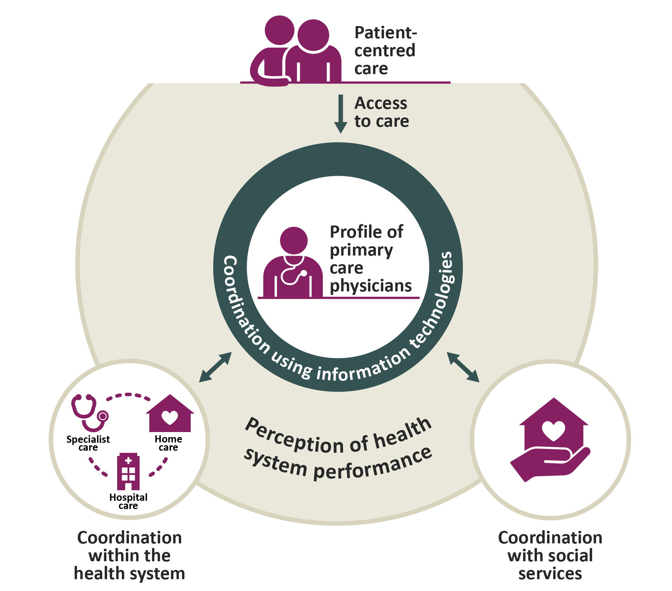
Reporting framework
Note
In Quebec, social services are an integral part of the health system (ministère de la Santé et des Services sociaux du Québec).
© 2020 Canadian Institute for Health Information
Notes:
How to cite this document:
Canadian Institute for Health Information. How Canada Compares: Results From the Commonwealth Fund’s 2019 International Health Policy Survey of Primary Care Physicians. Ottawa, ON: CIHI; 2020.

Slide 14
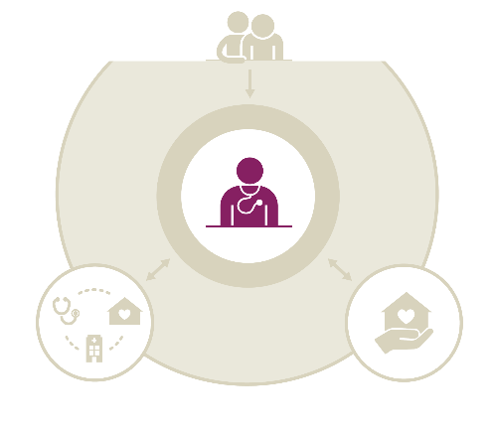
Profile of primary care physicians and their practices
Key findings
Canadian physicians see a median of 100 patients a week, similar to the 11-country average of medians (99 patients a week). 55% of Canadian primary care physicians spend 15 to less than 25 minutes with each patient, similar to the CMWF average (54%). Most Canadian primary care practices (61%) are not accepting new patients.
There were more physician group practices in Canada in 2019 than in 2015 (65% versus 60%), reflecting a trend away from solo practices. Notably, there is wide variation across the country in how practices are organized.
Slightly fewer Canadian primary care physicians are extremely, very or moderately satisfied with practising medicine (88%) and with their income from medical practice (76%) compared with the CMWF average (91% and 80%, respectively). However, slightly more Canadian primary care physicians are satisfied with their time spent per patient (69%) and daily workload (57%) compared with the CMWF average (62% and 52%, respectively).
More primary care physicians found their jobs stressful in 2019 than in 2015 (46% versus 27%). A similar trend was seen in the other CMWF countries (2015: 35%; 2019: 45%).
© 2020 Canadian Institute for Health Information
Notes:
How to cite this document:
Canadian Institute for Health Information. How Canada Compares: Results From the Commonwealth Fund’s 2019 International Health Policy Survey of Primary Care Physicians. Ottawa, ON: CIHI; 2020.

Slide 15
More Canadian primary care physicians worked in physician group practices in 2019 than in 2015
Primary practice site
2015
2019
2015
2019
2015
2019
2015
2019
© 2020 Canadian Institute for Health Information
Notes:
How to cite this document:
Canadian Institute for Health Information. How Canada Compares: Results From the Commonwealth Fund’s 2019 International Health Policy Survey of Primary Care Physicians. Ottawa, ON: CIHI; 2020.

Slide 16
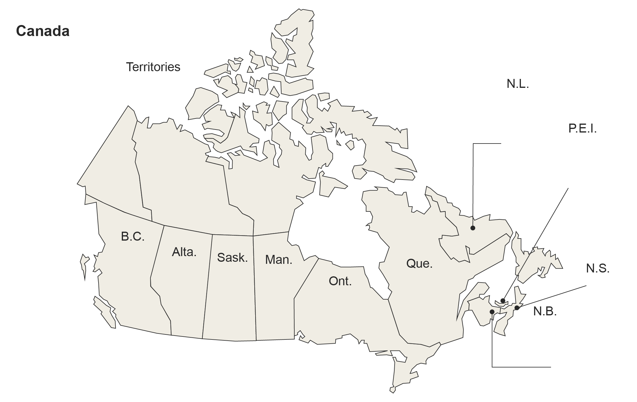
Variation across jurisdictions in primary care practice organization
Primary practice site
15%
65%
12%
5%
Private solo practice
—
45%
39%*
—
Physician group practice
17%*
43%
19%*
17%*
Community clinic/health centre
37%*
—
43%*
—
Hospital-based practice
14%*
74%
8%*
—
10%*
78%
—
—
12%*
58%
25%
—
18%*
47%
25%
—
9%
61%
16%
9%
17%
68%
6%
4%*
25%
53%
15%*
—
55%
22%*
16%*
—
Notes
* The coefficient of variation (CV) is between 16.6% and 33.3%; use with caution.
— Data is suppressed due to extreme sampling variability (CV>33.3%).
The Canadian average represents the average experience of Canadians (as opposed to the mean of provincial and territorial results).
© 2020 Canadian Institute for Health Information
Notes:
How to cite this document:
Canadian Institute for Health Information. How Canada Compares: Results From the Commonwealth Fund’s 2019 International Health Policy Survey of Primary Care Physicians. Ottawa, ON: CIHI; 2020.

Slide 17
Differences between solo and group physician practices
Proportion of primary care practices that do the following, by type of practice
Offer appointments on the weekend (i.e., Saturday or Sunday)
Use personnel, such as nurses or case managers, to monitor and manage care for patients with chronic conditions that need regular follow-up care
Use electronic patient medical records (not including billing systems)
Offer patients the option to request appointments online
Receive and review data on surveys of patient satisfaction and experiences with care quarterly or yearly
© 2020 Canadian Institute for Health Information
Notes:
How to cite this document:
Canadian Institute for Health Information. How Canada Compares: Results From the Commonwealth Fund’s 2019 International Health Policy Survey of Primary Care Physicians. Ottawa, ON: CIHI; 2020.

Slide 18
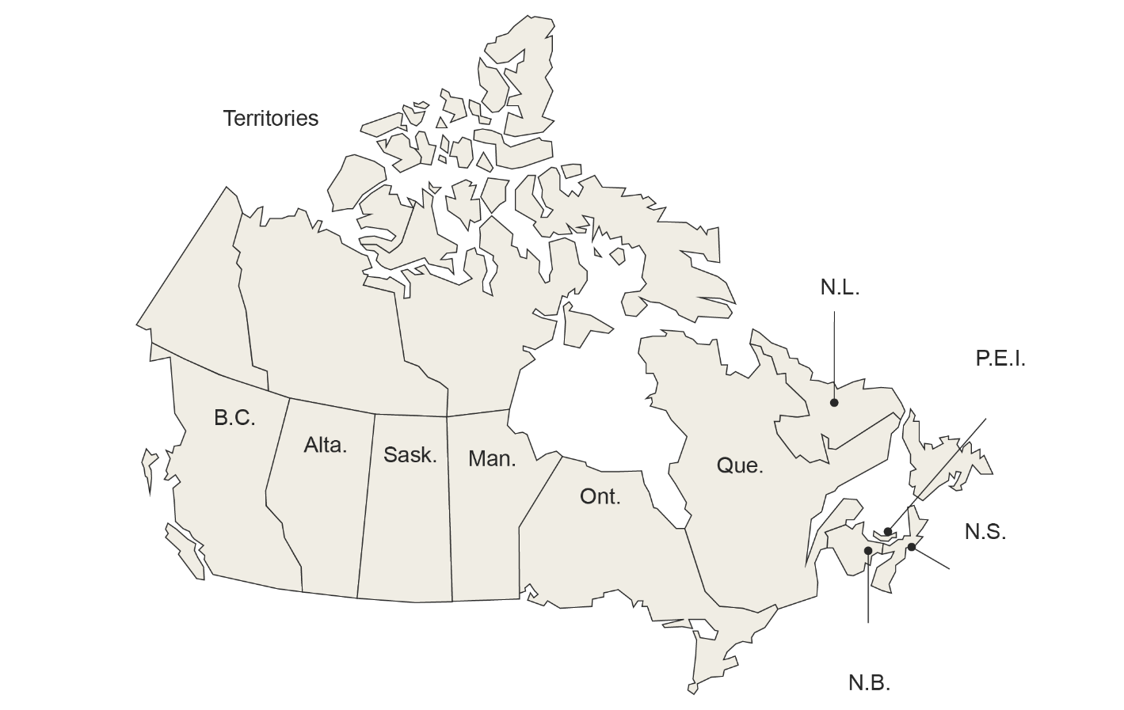
Canadian primary care physicians see 100 patients a week, with variability across jurisdictions
Median number of patients seen during a typical workweek
In 2016, 85% of Canadians had a regular doctor or place where they received care.¹
70
125
100
120
100
120
100
70
100
112
110
Note
The Canadian median represents the median experience of Canadians (as opposed to the average of provincial and territorial medians).
Non-directional or no statistical tests were performed to compare with the CMWF average (e.g., territories).
© 2020 Canadian Institute for Health Information
Notes:
Source
Canadian Institute for Health Information. How Canada Compares: Results From The Commonwealth Fund’s 2016 International Health Policy Survey of Adults in 11 Countries. 2017. https://www.cihi.ca/en/commonwealth-fund-survey-2016.
How to cite this document:
Canadian Institute for Health Information. How Canada Compares: Results From the Commonwealth Fund’s 2019 International Health Policy Survey of Primary Care Physicians. Ottawa, ON: CIHI; 2020.

Slide 19
Canadian physicians work similar hours as CMWF average
In addition to clinical activities as measured here, primary care physicians may work in teaching, health facility committees, administration, research and continuing medical education/continuing professional development.¹
Note
Including all hours they work across practices, including hours worked at home and on call.
© 2020 Canadian Institute for Health Information
Notes:
Source
Canadian Medical Association. Family Medicine Profile. 2018. https://www.cma.ca/sites/default/files/2019-01/family-e.pdf.
How to cite this document:
Canadian Institute for Health Information. How Canada Compares: Results From the Commonwealth Fund’s 2019 International Health Policy Survey of Primary Care Physicians. Ottawa, ON: CIHI; 2020.

Slide 20
Canadian primary care physicians spend similar amount of time with patients as CMWF average
Compared with 2015, there were no significant changes in the amount of time Canadian primary care physicians were able to spend with patients during routine office visits.¹
© 2020 Canadian Institute for Health Information
Notes:
Source
Canadian Institute for Health Information. How Canada Compares: Results From The Commonwealth Fund 2015 International Health Policy Survey of Primary Care Physicians. 2016. https://www.cihi.ca/en/commonwealth-fund-survey-2015.
How to cite this document:
Canadian Institute for Health Information. How Canada Compares: Results From the Commonwealth Fund’s 2019 International Health Policy Survey of Primary Care Physicians. Ottawa, ON: CIHI; 2020.

Slide 21
Physician satisfaction by time spent with patients
Proportion of Canadian primary care physicians who are extremely, very or moderately satisfied with the time they can spend with patients, by the amount of time they are able to spend with patients during routine office visits
57% of Canadians feel that their regular doctor always spends enough time with them when they need care or treatment.¹
© 2020 Canadian Institute for Health Information
Notes:
Source
Canadian Institute for Health Information. How Canada Compares: Results From The Commonwealth Fund’s 2016 International Health Policy Survey of Adults in 11 Countries. 2017. https://www.cihi.ca/en/commonwealth-fund-survey-2016.
How to cite this document:
Canadian Institute for Health Information. How Canada Compares: Results From the Commonwealth Fund’s 2019 International Health Policy Survey of Primary Care Physicians. Ottawa, ON: CIHI; 2020.

Slide 22
Provincial and territorial snapshot: Time
Proportion of primary care physicians by the number of hours they typically work each week in their medical practice
 | N.L. | P.E.I. | N.S. | N.B. | Que. | Ont. | Man. | Sask. | Alta. | B.C. | Terr. | Can. | CMWF avg.
Less than 35 hours | 9* | — | 13* | 14* | 29 | 17 | 12* | 9* | 13* | 19* | — | 18 | 20
35 to less than 45 hours | 25 | 22* | 20* | 20* | 27 | 30 | 17* | 13* | 27 | 24 | 25* | 26 | 26
45 or more hours | 66 | 65 | 67 | 66 | 44 | 53 | 72 | 77 | 61 | 57 | 60 | 55 | 54
Proportion of primary care physicians by the average amount of time they are able to spend with a patient during a routine office visit
 | N.L. | P.E.I. | N.S. | N.B. | Que. | Ont. | Man. | Sask. | Alta. | B.C. | Terr. | Can. | CMWF avg.
Less than 15 minutes | 43 | 34* | 28 | 34 | 2* | 34 | 29 | 34 | 19* | 58 | — | 28 | 32
15 to less than 25 minutes | 49 | 63 | 62 | 61 | 50 | 58 | 58 | 57 | 69 | 36 | 77 | 55 | 54
25 minutes or more | 8* | — | 10* | — | 48 | 7 | 13* | 9* | 12* | — | — | 18 | 14
Notes
* The coefficient of variation (CV) is between 16.6% and 33.3%; use with caution.
— Data is suppressed due to extreme sampling variability (CV>33.3%).
The Canadian average represents the average experience of Canadians (as opposed to the mean of provincial and territorial results).
Typical hours of work include all hours physicians work across practices, including hours worked at home and on call.
Non-directional or no statistical tests were performed to compare with the CMWF average (e.g., territories).
© 2020 Canadian Institute for Health Information
Notes:
How to cite this document:
Canadian Institute for Health Information. How Canada Compares: Results From the Commonwealth Fund’s 2019 International Health Policy Survey of Primary Care Physicians. Ottawa, ON: CIHI; 2020.

Slide 23
About two-thirds of Canadian primary care practices not accepting new patients
Proportion of primary care physicians who have the capacity to accept new patients in their main care setting, considering their roster and work schedule
Of those who have the capacity and are accepting new patients, proportion of primary care physicians who use the following strategies†
Use a waiting list maintained by the clinic
Use the public waiting list of patients maintained by the government
Put your name in the government list of available doctors
Use other strategies to fill capacity
Notes
† Excludes respondents who answered “not applicable” for each strategy.
Multiple responses were allowed, so the sum of responses does not total 100%.
© 2020 Canadian Institute for Health Information
Notes:
How to cite this document:
Canadian Institute for Health Information. How Canada Compares: Results From the Commonwealth Fund’s 2019 International Health Policy Survey of Primary Care Physicians. Ottawa, ON: CIHI; 2020.

Slide 24
Fewer Canadian primary care physicians satisfied with practising medicine and with their income compared with CMWF average
Proportion of primary care physicians who are extremely, very or moderately satisfied with practising medicine
Proportion of primary care physicians who are extremely, very or moderately satisfied with the following aspects of their medical practice
Their income from medical practice
The time they can spend per patient
Their daily workload
Note
The Netherlands is excluded as it used a different scale.
Above average
Same as average
Below average
© 2020 Canadian Institute for Health Information
Notes:
How to cite this document:
Canadian Institute for Health Information. How Canada Compares: Results From the Commonwealth Fund’s 2019 International Health Policy Survey of Primary Care Physicians. Ottawa, ON: CIHI; 2020.

Slide 25
Increasing proportion of Canadian primary care physicians find their jobs extremely or very stressful
Proportion of primary care physicians who feel extremely or very stressed with their job as a primary care physician
Desirable
2019
Above average
Same as average
Below average
© 2020 Canadian Institute for Health Information
Notes:
How to cite this document:
Canadian Institute for Health Information. How Canada Compares: Results From the Commonwealth Fund’s 2019 International Health Policy Survey of Primary Care Physicians. Ottawa, ON: CIHI; 2020.

Slide 26
Provincial and territorial snapshot: Satisfaction and stress
Proportion of primary care physicians who are extremely, very or moderately satisfied with . . .
 | N.L. | P.E.I. | N.S. | N.B. | Que. | Ont. | Man. | Sask. | Alta. | B.C. | Terr. | Can. | CMWF avg.
Practising medicine | 91 | 94 | 79 | 92 | 91 | 85 | 94 | 94 | 95 | 83 | 91 | 88 | 91
Their income from medical practice | 69 | 84 | 62 | 79 | 93 | 63 | 87 | 80 | 86 | 67 | 94 | 76 | 80
The time they can spend per patient | 69 | 80 | 51 | 72 | 81 | 64 | 71 | 67 | 81 | 49 | 71 | 69 | 62
Their daily workload | 57 | 66 | 38 | 64 | 65 | 51 | 62 | 63 | 69 | 48 | 60 | 57 | 52
Proportion of primary care physicians who feel extremely or very stressed with . . .
 | N.L. | P.E.I. | N.S. | N.B. | Que. | Ont. | Man. | Sask. | Alta. | B.C. | Terr. | Can. | CMWF avg.
Their job as a primary care physician† | 46 | 48* | 61 | 42 | 34 | 55 | 43 | 45 | 40 | 48 | 49 | 46 | 45
Notes
* The coefficient of variation (CV) is between 16.6% and 33.3%; use with caution.
† Lower results are more desirable.
The CMWF average was calculated by adding the results from the 11 countries and dividing by the number of countries. The Canadian average represents the average experience of Canadians (as opposed to the mean of provincial and territorial results).
Above-average results are more desirable relative to the international average, while below-average results often indicate areas in need of improvement.
Above average
Same as average
Below average
Non-directional or no statistical tests were performed to compare with the CMWF average (e.g., territories).
© 2020 Canadian Institute for Health Information
Notes:
How to cite this document:
Canadian Institute for Health Information. How Canada Compares: Results From the Commonwealth Fund’s 2019 International Health Policy Survey of Primary Care Physicians. Ottawa, ON: CIHI; 2020.

Slide 27
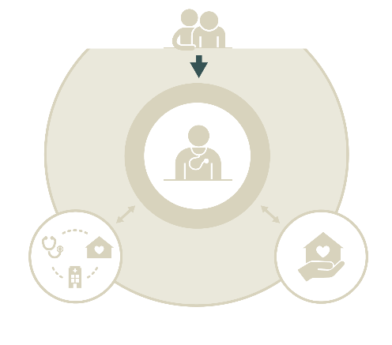
Access to care
Key findings
More Canadian primary care physicians offer weeknight (57%) and weekend (50%) appointments compared with the CMWF average (weeknight: 44%; weekend: 36%). However, only 49% of Canadian primary care physicians have arrangements for patients to be seen when their practices are closed, lower than the CMWF average (75%).
22% of Canadian primary care physicians offered patients the option to request appointments online in 2019, compared with 11% in 2015.
Fewer Canadian primary care physicians (23%) offer patients the option to ask medical questions via email or a secure website compared with the CMWF average (65%). There are also fewer Canadian primary care physicians (18%) who frequently make home visits compared with the CMWF average (42%).
© 2020 Canadian Institute for Health Information
Notes:
How to cite this document:
Canadian Institute for Health Information. How Canada Compares: Results From the Commonwealth Fund’s 2019 International Health Policy Survey of Primary Care Physicians. Ottawa, ON: CIHI; 2020.

Slide 28
More Canadian primary care physicians offer weeknight and weekend appointments than CMWF average
Proportion of primary care physicians whose practice offers appointments after 6 p.m. during the week (i.e., Monday to Friday) at least once a week†
Proportion of primary care physicians whose practice offers appointments on the weekend (i.e., Saturday or Sunday) at least once a month‡
Notes
† Excludes respondents from Norway who answered “Not applicable, patients can use the emergency room on weekdays.”
‡ Excludes respondents from Norway who answered “Not applicable, patients can be seen in primary care after-hours clinics on the weekends.”
In 2016, only 34% of Canadians reported that it was very or somewhat easy to get medical care in the evenings, on weekends or on holidays without going to the hospital emergency department.¹
Above average
Same as average
Below average
© 2020 Canadian Institute for Health Information
Notes:
Source
Canadian Institute for Health Information. How Canada Compares: Results From The Commonwealth Fund’s 2016 International Health Policy Survey of Adults in 11 Countries. 2017. https://www.cihi.ca/en/commonwealth-fund-survey-2016.
How to cite this document:
Canadian Institute for Health Information. How Canada Compares: Results From the Commonwealth Fund’s 2019 International Health Policy Survey of Primary Care Physicians. Ottawa, ON: CIHI; 2020.

Slide 29
Provincial and territorial snapshot: Access outside of regular hours
Proportion of primary care physicians whose practice offers appointments . . .
 | N.L. | P.E.I. | N.S. | N.B. | Que. | Ont. | Man. | Sask. | Alta. | B.C. | Terr. | Can. | CMWF avg.
After 6 p.m. during the week (i.e., Monday to Friday) at least once a week† | 45 | 35* | 54 | 28 | 69 | 75 | 27 | 37 | 42 | 28 | 46 | 57 | 44
On the weekend (i.e., Saturday or Sunday) at least once a month‡ | 40 | — | 31 | 16* | 61 | 57 | 35 | 31 | 47 | 41 | 38* | 50 | 36
Notes
* The coefficient of variation (CV) is between 16.6% and 33.3%; use with caution.
— Data is suppressed due to extreme sampling variability (CV>33.3%).
† Excludes respondents from Norway who answered “Not applicable, patients can use the emergency room on weekdays.”
‡ Excludes respondents from Norway who answered “Not applicable, patients can be seen in primary care after-hours clinics on the weekends.”
The CMWF average was calculated by adding the results from the 11 countries and dividing by the number of countries. The Canadian average represents the average experience of Canadians (as opposed to the mean of provincial and territorial results).
Above average
Same as average
Below average
Non-directional or no statistical tests were performed to compare with the CMWF average (e.g., territories).
© 2020 Canadian Institute for Health Information
Notes:
How to cite this document:
Canadian Institute for Health Information. How Canada Compares: Results From the Commonwealth Fund’s 2019 International Health Policy Survey of Primary Care Physicians. Ottawa, ON: CIHI; 2020.

Slide 30
Fewer Canadian primary care physicians have after-hours arrangements than CMWF average
Proportion of primary care physicians whose practice has an arrangement, either internally or with another practice, where patients can be seen by a doctor or nurse when the practice is closed (e.g., after hours)
Of those who have arrangements, proportion of primary care physicians who usually receive notifications that their patients have been seen for after-hours care
In 2015, Canadian primary care physicians reported similar results for having arrangements when the practice is closed. Canada’s place among other countries was similar in both 2015 and 2019.¹
Above average
Same as average
Below average
© 2020 Canadian Institute for Health Information
Notes:
Source
Canadian Institute for Health Information. How Canada Compares: Results From The Commonwealth Fund 2015 International Health Policy Survey of Primary Care Physicians. 2016. https://www.cihi.ca/en/commonwealth-fund-survey-2015.
How to cite this document:
Canadian Institute for Health Information. How Canada Compares: Results From the Commonwealth Fund’s 2019 International Health Policy Survey of Primary Care Physicians. Ottawa, ON: CIHI; 2020.

Slide 31
Provincial and territorial snapshot: After-hours arrangements
Proportion of primary care physicians whose practice . . .
 | N.L. | P.E.I. | N.S. | N.B. | Que. | Ont. | Man. | Sask. | Alta. | B.C. | Terr. | Can. | CMWF avg.
Has an arrangement, either internally or with another practice, where patients can be seen by a doctor or nurse when the practice is closed (e.g., after hours) | 35 | — | 34 | 39 | 39 | 64 | 28 | 38 | 59 | 37 | — | 49 | 75
Of those who have arrangements, proportion of primary care physicians who . . .
 | N.L. | P.E.I. | N.S. | N.B. | Que. | Ont. | Man. | Sask. | Alta. | B.C. | Terr. | Can. | CMWF avg.
Usually receive notifications that their patients have been seen for after-hours care | 35 | 58 | 51 | 58 | 10 | 26 | 23 | 32 | 37 | 35 | 37* | 28 | 45
Notes
* The coefficient of variation (CV) is between 16.6% and 33.3%; use with caution.
— Data is suppressed due to extreme sampling variability (CV>33.3%).
The CMWF average was calculated by adding the results from the 11 countries and dividing by the number of countries. The Canadian average represents the average experience of Canadians (as opposed to the mean of provincial and territorial results).
Above average
Same as average
Below average
Non-directional or no statistical tests were performed to compare with the CMWF average (e.g., territories).
© 2020 Canadian Institute for Health Information
Notes:
How to cite this document:
Canadian Institute for Health Information. How Canada Compares: Results From the Commonwealth Fund’s 2019 International Health Policy Survey of Primary Care Physicians. Ottawa, ON: CIHI; 2020.

Slide 32
Fewer Canadian primary care physicians offer access to patients electronically compared with CMWF average
Proportion of primary care physicians whose practice offers patients the following options
Communicate with their practice via email or a secure website about a medical question or concern
Request appointments online (not including email)
In 2016, 4% of Canadians had emailed their regular practice with a medical question in the preceding 2 years.¹
In 2015² and 2017,³ 11% of Canadian primary care physicians reported having offered patients the option to request appointments online.
Above average
Same as average
Below average
© 2020 Canadian Institute for Health Information
Notes:
Sources
Canadian Institute for Health Information. How Canada Compares: Results From The Commonwealth Fund’s 2016 International Health Policy Survey of Adults in 11 Countries. 2017. https://www.cihi.ca/en/commonwealth-fund-survey-2016.
Canadian Institute for Health Information. How Canada Compares: Results From The Commonwealth Fund 2015 International Health Policy Survey of Primary Care Physicians. 2016. https://www.cihi.ca/en/commonwealth-fund-survey-2015.
Canadian Medical Association. CMA Physician Workforce Survey, 2017. 2017. https://surveys.cma.ca/en/viewer?file=%2fdocuments%2fSurveyPDF%2fCMA_Survey_Workforce2017_Q24_ElectronicToolsPatients-e.pdf#search=%22Q24.%20Electronic%20tools%20used%20by%20patients%22&phrase=false.
How to cite this document:
Canadian Institute for Health Information. How Canada Compares: Results From the Commonwealth Fund’s 2019 International Health Policy Survey of Primary Care Physicians. Ottawa, ON: CIHI; 2020.

Slide 33
Provincial and territorial snapshot: Electronic access
Proportion of primary care physicians whose practice offers patients the option to . . .
 | N.L. | P.E.I. | N.S. | N.B. | Que. | Ont. | Man. | Sask. | Alta. | B.C. | Terr. | Can. | CMWF avg.
Communicate with their practice via email or a secure website about a medical question or concern | 9* | — | 25 | 12* | 17 | 30 | 22* | 11* | 23* | 24 | — | 23 | 65
Request appointments online (not including email) | — | — | 11* | 10* | 32 | 19 | 27 | 16* | 19* | 27 | 0 | 22 | 56
Notes
* The coefficient of variation (CV) is between 16.6% and 33.3%; use with caution.
— Data is suppressed due to extreme sampling variability (CV>33.3%).
The CMWF average was calculated by adding the results from the 11 countries and dividing by the number of countries. The Canadian average represents the average experience of Canadians (as opposed to the mean of provincial and territorial results).
Above average
Same as average
Below average
Non-directional or no statistical tests were performed to compare with the CMWF average (e.g., territories).
© 2020 Canadian Institute for Health Information
Notes:
How to cite this document:
Canadian Institute for Health Information. How Canada Compares: Results From the Commonwealth Fund’s 2019 International Health Policy Survey of Primary Care Physicians. Ottawa, ON: CIHI; 2020.

Slide 34
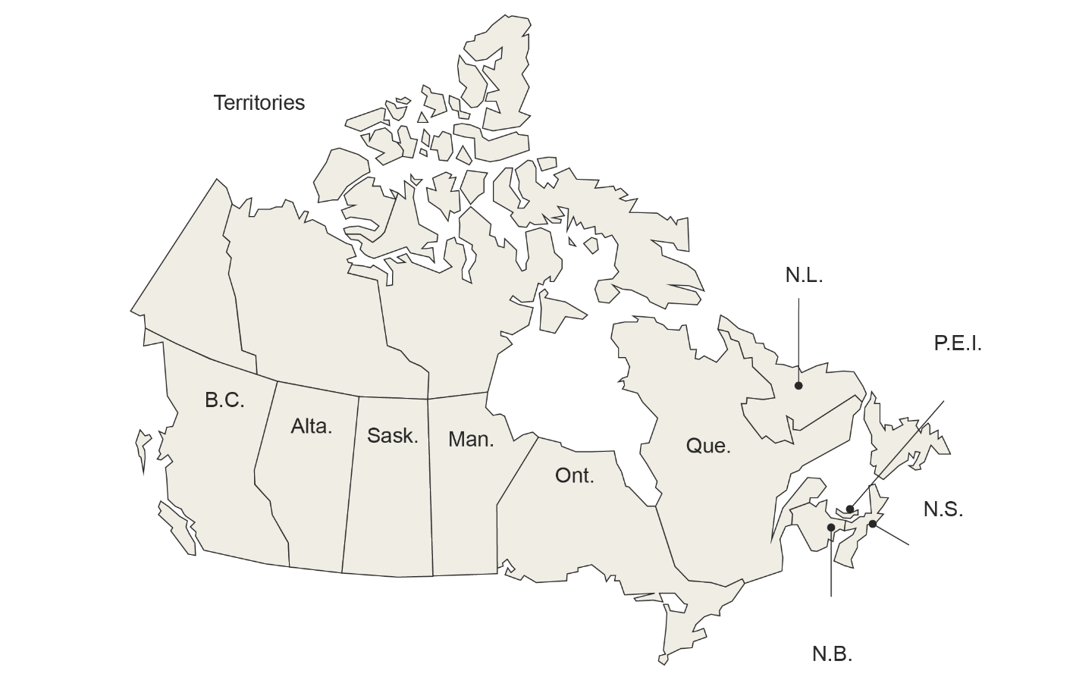
Fewer Canadian primary care physicians frequently make home visits compared with CMWF average
Proportion of primary care physicians who responded that they or other health care professionals in their practice frequently make home visits
In 2015, 19% of Canadian primary care physicians frequently made home visits (below the CMWF average of 39%),¹ similar to this year’s Canadian result (18%).
18%*
33%
—
14%*
9%*
18%*
12%*
25%
18%
22%*
13%*
Notes
* The coefficient of variation (CV) is between 16.6% and 33.3%; use with caution.
— Data is suppressed due to extreme sampling variability (CV>33.3%).
The CMWF average was calculated by adding the results from the 11 countries and dividing by the number of countries. The Canadian average represents the average experience of Canadians (as opposed to the mean of provincial and territorial results).
Above average
Same as average
Below average
Non-directional or no statistical tests were performed to compare with the CMWF average (e.g., territories).
© 2020 Canadian Institute for Health Information
Notes:
Source
Canadian Institute for Health Information. How Canada Compares: Results From The Commonwealth Fund 2015 International Health Policy Survey of Primary Care Physicians. 2016. https://www.cihi.ca/en/commonwealth-fund-survey-2015.
How to cite this document:
Canadian Institute for Health Information. How Canada Compares: Results From the Commonwealth Fund’s 2019 International Health Policy Survey of Primary Care Physicians. Ottawa, ON: CIHI; 2020.

Slide 35
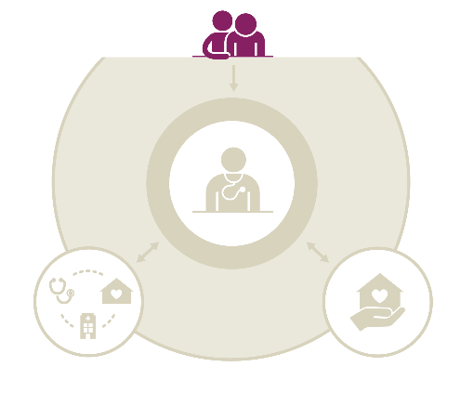
Patient-centred care
Key findings
The majority of Canadian primary care physicians feel well prepared to care for patients with chronic conditions (82%). In contrast, fewer Canadian primary care physicians feel prepared to care for patients with specialized needs, particularly dementia (40%), palliative care (36%) and substance use (19%) — below the CMWF averages (46%, 51% and 22%, respectively). In Canada, 13% of primary care physicians reported feeling well prepared to care for patients requesting medical assistance in dying (Canada only).
© 2020 Canadian Institute for Health Information
Notes:
How to cite this document:
Canadian Institute for Health Information. How Canada Compares: Results From the Commonwealth Fund’s 2019 International Health Policy Survey of Primary Care Physicians. Ottawa, ON: CIHI; 2020.

Slide 36
Few primary care physicians in Canada and internationally well prepared to care for patients with substance-use conditions
Proportion of primary care physicians whose practice is well prepared, with respect to having sufficient skills and experience, to manage care for patients with . . .
Chronic conditions
Mental illness (e.g., anxiety, mild or moderate depression)
Dementia
Substance-use conditions (e.g., drug, opioid or alcohol use)
Above average
Same as average
Below average
© 2020 Canadian Institute for Health Information
Notes:
How to cite this document:
Canadian Institute for Health Information. How Canada Compares: Results From the Commonwealth Fund’s 2019 International Health Policy Survey of Primary Care Physicians. Ottawa, ON: CIHI; 2020.

Slide 37
Provincial and territorial snapshot: Specialized needs
Proportion of primary care physicians whose practice is well prepared, with respect to having sufficient skills and experience, to manage care for patients with . . .
 | N.L. | P.E.I. | N.S. | N.B. | Que. | Ont. | Man. | Sask. | Alta. | B.C. | Terr. | Can. | CMWF avg.
Chronic conditions | 85 | 79 | 90 | 82 | 77 | 85 | 83 | 87 | 86 | 85 | 64 | 82 | 84
Mental illness (e.g., anxiety, mild or moderate depression) | 60 | 33* | 65 | 63 | 58 | 62 | 61 | 60 | 69 | 67 | 40* | 61 | 62
Dementia | 46 | 34* | 52 | 50 | 41 | 36 | 43 | 39 | 36 | 48 | 19* | 40 | 46
Substance-use conditions (e.g., drug, opioid or alcohol use) | 25 | — | 28 | 17* | 12 | 19 | 27 | 28 | 23* | 23* | 21* | 19 | 22
Notes
* The coefficient of variation (CV) is between 16.6% and 33.3%; use with caution.
— Data is suppressed due to extreme sampling variability (CV>33.3%).
The CMWF average was calculated by adding the results from the 11 countries and dividing by the number of countries. The Canadian average represents the average experience of Canadians (as opposed to the mean of provincial and territorial results).
Above average
Same as average
Below average
Non-directional or no statistical tests were performed to compare with the CMWF average (e.g., territories).
© 2020 Canadian Institute for Health Information
Notes:
How to cite this document:
Canadian Institute for Health Information. How Canada Compares: Results From the Commonwealth Fund’s 2019 International Health Policy Survey of Primary Care Physicians. Ottawa, ON: CIHI; 2020.

Slide 38
Fewer Canadian primary care physicians use personnel to care for patients with chronic conditions compared with CMWF average
Proportion of primary care physicians who use personnel, such as nurses or case managers, to monitor and manage care for patients with chronic conditions that need regular follow-up care
54%
47%
71%
43%
82%
62%
57%
80%
51%
56%
60%
Note
The CMWF average was calculated by adding the results from the 11 countries and dividing by the number of countries. The Canadian average represents the average experience of Canadians (as opposed to the mean of provincial and territorial results).
Above average
Same as average
Below average
Non-directional or no statistical tests were performed to compare with the CMWF average (e.g., territories).
© 2020 Canadian Institute for Health Information
Notes:
How to cite this document:
Canadian Institute for Health Information. How Canada Compares: Results From the Commonwealth Fund’s 2019 International Health Policy Survey of Primary Care Physicians. Ottawa, ON: CIHI; 2020.

Slide 39
Management of chronic conditions
Proportion of primary care physicians who responded that they or other health care professionals in their practice usually or often provide care for patients with chronic conditions in the following ways
Develop treatment plans with patients they can carry out in their daily life
Provide patients with written instructions about how to manage their own care at home
Record patients’ self-management goals in their medical record
Contact patients between visits to monitor their condition
Above average
Same as average
Below average
© 2020 Canadian Institute for Health Information
Notes:
How to cite this document:
Canadian Institute for Health Information. How Canada Compares: Results From the Commonwealth Fund’s 2019 International Health Policy Survey of Primary Care Physicians. Ottawa, ON: CIHI; 2020.

Slide 40
Provincial and territorial snapshot: Management of chronic conditions
Proportion of primary care physicians who responded that they or other health care professionals in their practice usually or often provide care for patients with chronic conditions in the following ways
 | N.L. | P.E.I. | N.S. | N.B. | Que. | Ont. | Man. | Sask. | Alta. | B.C. | Terr. | Can. | CMWF avg.
Develop treatment plans with patients they can carry out in their daily life | 80 | 78 | 81 | 71 | 51 | 78 | 85 | 89 | 85 | 84 | 67 | 74 | 69
Provide patients with written instructions about how to manage their own care at home | 43 | 54 | 46 | 41 | 38 | 47 | 53 | 60 | 55 | 51 | 46 | 47 | 53
Record patients’ self-management goals in their medical record | 44 | 51* | 43 | 40 | 37 | 44 | 46 | 63 | 61 | 60 | 32* | 47 | 46
Contact patients between visits to monitor their condition | 26 | 37* | 28 | 22 | 48 | 28 | 33 | 36 | 41 | 30 | 21* | 35 | 32
Notes
* The coefficient of variation (CV) is between 16.6% and 33.3%; use with caution.
The CMWF average was calculated by adding the results from the 11 countries and dividing by the number of countries. The Canadian average represents the average experience of Canadians (as opposed to the mean of provincial and territorial results).
Above average
Same as average
Below average
Non-directional or no statistical tests were performed to compare with the CMWF average (e.g., territories).
© 2020 Canadian Institute for Health Information
Notes:
How to cite this document:
Canadian Institute for Health Information. How Canada Compares: Results From the Commonwealth Fund’s 2019 International Health Policy Survey of Primary Care Physicians. Ottawa, ON: CIHI; 2020.

Slide 41
Most Canadian primary care physicians have end-of-life conversations with patients
Proportion of primary care physicians who routinely or occasionally have end-of-life conversations with their patients about their preferences, wishes and goals for their care, in the event they become very ill or injured or cannot make decisions for themselves†
66% of Canadian seniors have had a discussion with family, a close friend or a health care professional about the health care treatment they want or do not want in the event that they cannot make decisions for themselves.¹
Note
† Excludes respondents who answered “does not apply.”
Above average
Same as average
Below average
© 2020 Canadian Institute for Health Information
Notes:
Sources
Canadian Institute for Health Information. How Canada Compares: Results From The Commonwealth Fund’s 2017 International Health Policy Survey of Seniors. 2018. https://www.cihi.ca/sites/default/files/document/commonwealth-survey-2017-chartbook-en-rev2-web.pptx.
How to cite this document:
Canadian Institute for Health Information. How Canada Compares: Results From the Commonwealth Fund’s 2019 International Health Policy Survey of Primary Care Physicians. Ottawa, ON: CIHI; 2020.

Slide 42
Fewer Canadian primary care physicians well prepared to manage patients with palliative needs compared with CMWF average
Proportion of primary care physicians who feel well prepared, with respect to having sufficient skills and experience, to manage care for patients with palliative care needs
Palliative care rotations are currently not mandatory for family physicians in Canada;¹ completing one is recognized with a Certificate of Added Competence as an enhanced skill.² This may explain why few Canadian primary care physicians feel well prepared to care for patients with palliative needs.
In total, 8.5% of Canadian primary care physicians have a practice focus on palliative care.³
Above average
Same as average
Below average
© 2020 Canadian Institute for Health Information
Notes:
Sources
Downar J. Resources for educating, training, and mentoring all physicians providing palliative care. Journal of Palliative Medicine. 2018. https://doi.org/10.1089/jpm.2017.0396.
The College of Family Physicians of Canada. Standards of Accreditation for Residency Programs in Family Medicine. 2018. https://www.cfpc.ca/uploadedFiles/_Shared_Elements/Documents/20180701_RB_V1.2_ENG.pdf.
Canadian Medical Association. CMA Physician Workforce Survey, 2017. 2017. https://surveys.cma.ca/en/viewer?file=%2fdocuments%2fSurveyPDF%2fCMA_Survey_Workforce2017_Q6i_FPfocus-e.pdf#search=%22Q06iFP.%20Family%20Practice%20Focus%22&phrase=false.
How to cite this document:
Canadian Institute for Health Information. How Canada Compares: Results From the Commonwealth Fund’s 2019 International Health Policy Survey of Primary Care Physicians. Ottawa, ON: CIHI; 2020.

Slide 43
Provincial and territorial snapshot: Palliative and end-of-life care
Proportion of primary care physicians who . . .
 | N.L. | P.E.I. | N.S. | N.B. | Que. | Ont. | Man. | Sask. | Alta. | B.C. | Terr. | Can. | CMWF avg.
Routinely or occasionally have end-of-life conversations with their patients† | 93 | 98 | 97 | 99 | 94 | 91 | 93 | 96 | 97 | 97 | 98 | 94 | 92
Feel well prepared to manage care for patients with palliative care needs | 55 | 48* | 54 | 60 | 30 | 33 | 50 | 48 | 30 | 46 | 44 | 36 | 51
Notes
* The coefficient of variation (CV) is between 16.6% and 33.3%; use with caution.
† Excludes respondents who answered “does not apply.”
The CMWF average was calculated by adding the results from the 11 countries and dividing by the number of countries. The Canadian average represents the average experience of Canadians (as opposed to the mean of provincial and territorial results).
Above average
Same as average
Below average
Non-directional or no statistical tests were performed to compare with the CMWF average (e.g., territories).
© 2020 Canadian Institute for Health Information
Notes:
How to cite this document:
Canadian Institute for Health Information. How Canada Compares: Results From the Commonwealth Fund’s 2019 International Health Policy Survey of Primary Care Physicians. Ottawa, ON: CIHI; 2020.

Slide 44
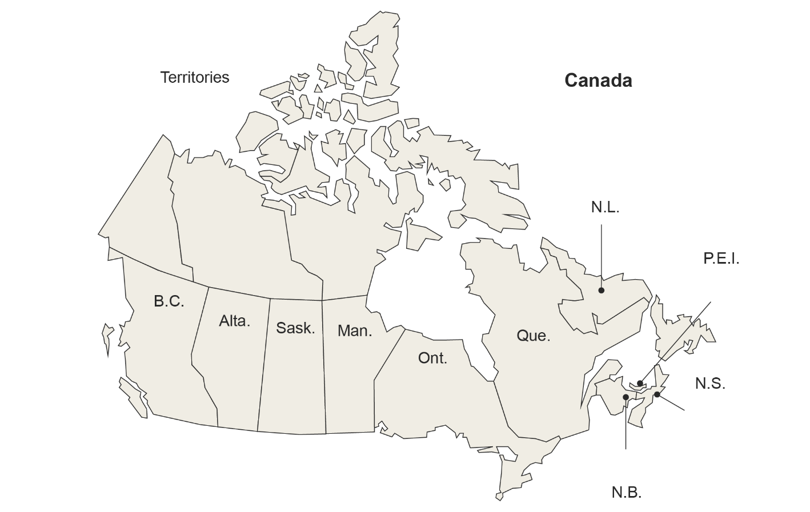
Few Canadian primary care physicians well prepared to manage patients requesting medical assistance in dying
Proportion of primary care physicians whose practice is well prepared, with respect to having sufficient skills and experience, to manage care for patients requesting medical assistance in dying
13%
Did you know?
Medical assistance in dying is not considered part of palliative care, but it is an end-of-life option for Canadians who meet the legal criteria.
Between December 10, 2015 (when the law was enacted) and October 31, 2018, there were 6,749 medically assisted deaths in Canada.¹
25%*
12%*
—
19%*
13%*
11%*
15%*
12%
12%
15%*
24%
Notes
* The coefficient of variation (CV) is between 16.6% and 33.3%; use with caution.
— Data is suppressed due to extreme sampling variability (CV>33.3%).
The Canadian average represents the average experience of Canadians (as opposed to the mean of provincial and territorial results).
Non-directional or no statistical tests were performed to compare with the CMWF average (e.g., territories).
© 2020 Canadian Institute for Health Information
Notes:
Source
Health Canada. Fourth Interim Report on Medical Assistance in Dying in Canada. 2019. https://www.canada.ca/en/health-canada/services/publications/health-system-services/medical-assistance-dying-interim-report-april-2019.html.
How to cite this document:
Canadian Institute for Health Information. How Canada Compares: Results From the Commonwealth Fund’s 2019 International Health Policy Survey of Primary Care Physicians. Ottawa, ON: CIHI; 2020.

Slide 45
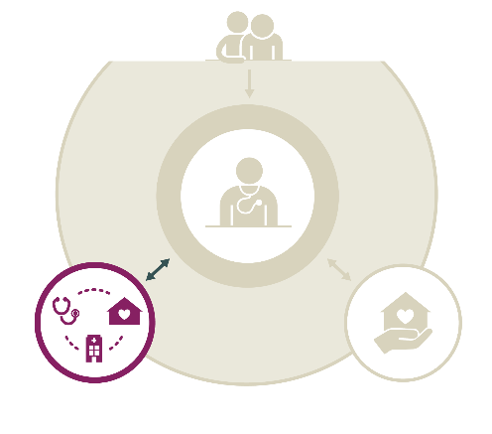
Coordination within the health system
Key findings
While more Canadian primary care physicians send information to specialists (90%) compared with the CMWF average (85%), timely transfer of information back from specialists is lower in Canada (17% versus 21%).
The proportions of Canadian primary care physicians who usually receive notifications that patients had visited the emergency department (49%) and had been hospitalized (54%) are similar to the CMWF averages (51% and 55%, respectively).
Fewer Canadian primary care physicians communicate with home care providers about their patients’ needs (24%) compared with the CMWF average (31%). However, about the same proportion of Canadian physicians receives updates about their patients (36% versus 37%).
© 2020 Canadian Institute for Health Information
Notes:
How to cite this document:
Canadian Institute for Health Information. How Canada Compares: Results From the Commonwealth Fund’s 2019 International Health Policy Survey of Primary Care Physicians. Ottawa, ON: CIHI; 2020.

Slide 46
Two-way communication between primary care physicians and specialists
When their patients have been referred to a specialist, percentage of primary care physicians who usually . . .
Send the patient history and the reason for the consultation to the specialist
Receive from the specialist information about changes made to the patient’s medication or care plan
Receive a report with the results of the specialist visit within 1 week of service
In 2016, 13% of Canadians reported that their specialist did not have basic information or test results from their regular doctor about the reason for their visit,¹ and 21% reported that their regular doctor did not seem informed and up to date about the care they received from the specialist.¹
Above average
Same as average
Below average
© 2020 Canadian Institute for Health Information
Notes:
Source
Canadian Institute for Health Information. How Canada Compares: Results From The Commonwealth Fund’s 2016 International Health Policy Survey of Adults in 11 Countries. 2017. https://www.cihi.ca/en/commonwealth-fund-survey-2016.
How to cite this document:
Canadian Institute for Health Information. How Canada Compares: Results From the Commonwealth Fund’s 2019 International Health Policy Survey of Primary Care Physicians. Ottawa, ON: CIHI; 2020.

Slide 47
Provincial and territorial snapshot: Communication with specialists
When their patients have been referred to a specialist, proportion of primary care physicians who usually . . .
 | N.L. | P.E.I. | N.S. | N.B. | Que. | Ont. | Man. | Sask. | Alta. | B.C. | Terr. | Can. | CMWF avg.
Send the patient history and the reason for the consultation to the specialist | 96 | 95 | 99 | 94 | 69 | 98 | 94 | 96 | 96 | 98 | 96 | 90 | 85
Receive from the specialist information about changes made to the patient’s medication or care plan | 59 | 69 | 77 | 71 | 30 | 67 | 63 | 68 | 66 | 73 | 70 | 59 | 58
Receive a report with the results of the specialist visit within 1 week of service | 12* | — | 11* | 11* | 11 | 18 | 14* | 26 | 17* | 23* | — | 17 | 21
Notes
* The coefficient of variation (CV) is between 16.6% and 33.3%; use with caution.
— Data is suppressed due to extreme sampling variability (CV>33.3%).
The CMWF average was calculated by adding the results from the 11 countries and dividing by the number of countries. The Canadian average represents the average experience of Canadians (as opposed to the mean of provincial and territorial results).
Above average
Same as average
Below average
Non-directional or no statistical tests were performed to compare with the CMWF average (e.g., territories).
© 2020 Canadian Institute for Health Information
Notes:
How to cite this document:
Canadian Institute for Health Information. How Canada Compares: Results From the Commonwealth Fund’s 2019 International Health Policy Survey of Primary Care Physicians. Ottawa, ON: CIHI; 2020.

Slide 48
Half of Canadian primary care physicians usually receive notifications of patients’ emergency department visits
Proportion of primary care physicians who usually receive notifications that their patients have been seen in an emergency department
60%
54%
82%
69%
42%
44%
48%
17%
59%
75%
87%
Note
The CMWF average was calculated by adding the results from the 11 countries and dividing by the number of countries. The Canadian average represents the average experience of Canadians (as opposed to the mean of provincial and territorial results).
Above average
Same as average
Below average
Non-directional or no statistical tests were performed to compare with the CMWF average (e.g., territories).
© 2020 Canadian Institute for Health Information
Notes:
How to cite this document:
Canadian Institute for Health Information. How Canada Compares: Results From the Commonwealth Fund’s 2019 International Health Policy Survey of Primary Care Physicians. Ottawa, ON: CIHI; 2020.

Slide 49
Many Canadian primary care physicians receive notifications of patients’ hospital stays within 2 weeks
Proportion of primary care physicians who usually receive notifications that their patients have been admitted to a hospital
After their patients have been discharged from a hospital, average length of time Canadian primary care physicians wait to receive the information they need to continue managing the patient, including recommended follow-up care
Same as 2015¹
64% of family physicians use electronic tools to receive hospital visit and discharge information.²
Above average
Same as average
Below average
© 2020 Canadian Institute for Health Information
Notes:
Sources
Canadian Institute for Health Information. How Canada Compares: Results From The Commonwealth Fund 2015 International Health Policy Survey of Primary Care Physicians. 2016. https://www.cihi.ca/en/commonwealth-fund-survey-2015.
Canadian Medical Association. CMA Physician Workforce Survey, 2017. 2017. https://surveys.cma.ca/en/viewer?file=%2fdocuments%2fSurveyPDF%2fCMA_Survey_Workforce2017_Q23_ElectronicToolsUsed-e.pdf#search=%22Q23.%20Electronic%20tools%20used%20by%20physicians%22&phrase=false.
How to cite this document:
Canadian Institute for Health Information. How Canada Compares: Results From the Commonwealth Fund’s 2019 International Health Policy Survey of Primary Care Physicians. Ottawa, ON: CIHI; 2020.

Slide 50
Provincial and territorial snapshot: Communication with hospitals
Proportion of primary care physicians who usually receive notifications that their patients have been . . .
 | N.L. | P.E.I. | N.S. | N.B. | Que. | Ont. | Man. | Sask. | Alta. | B.C. | Terr. | Can. | CMWF avg.
Admitted to a hospital | 49 | 77 | 72 | 78 | 25 | 64 | 41 | 53 | 52 | 76 | 63 | 54 | 55
After their patients have been discharged from a hospital, average length of time primary care physicians wait to receive the information they need to continue managing the patient, including recommended follow-up care (proportion of physicians)
 | N.L. | P.E.I. | N.S. | N.B. | Que. | Ont. | Man. | Sask. | Alta. | B.C. | Terr. | Can. | CMWF avg.
0–4 days | 25 | 36* | 50 | 35 | 18 | 62 | 36 | 51 | 55 | 63 | 43* | 48 | 61
15+ days, or never | 34 | 28* | 15* | 33 | 51 | 8 | 27 | 10* | 16* | 10* | — | 22 | 12
Notes
* The coefficient of variation (CV) is between 16.6% and 33.3%; use with caution.
— Data is suppressed due to extreme sampling variability (CV>33.3%).
The CMWF average was calculated by adding the results from the 11 countries and dividing by the number of countries. The Canadian average represents the average experience of Canadians (as opposed to the mean of provincial and territorial results).
Above average
Same as average
Below average
Non-directional or no statistical tests were performed to compare with the CMWF average (e.g., territories).
© 2020 Canadian Institute for Health Information
Notes:
How to cite this document:
Canadian Institute for Health Information. How Canada Compares: Results From the Commonwealth Fund’s 2019 International Health Policy Survey of Primary Care Physicians. Ottawa, ON: CIHI; 2020.

Slide 51
A quarter of Canadian primary care physicians communicate with home-based nursing care about their patients’ needs
For patients who receive home-based nursing care, proportion of primary care physicians who usually . . .
Communicate with home-based nursing care providers about their patients’ needs and the services to be provided†
Are advised by the home-based nursing care providers of a relevant change in their patients’ condition or health status†
Note
† Excludes respondents who answered “does not apply.”
Above average
Same as average
Below average
© 2020 Canadian Institute for Health Information
Notes:
How to cite this document:
Canadian Institute for Health Information. How Canada Compares: Results From the Commonwealth Fund’s 2019 International Health Policy Survey of Primary Care Physicians. Ottawa, ON: CIHI; 2020.

Slide 52
Provincial and territorial snapshot: Communication with home-based nursing care
For patients who receive home-based nursing care, percentage of primary care physicians who usually . . .
 | N.L. | P.E.I. | N.S. | N.B. | Que. | Ont. | Man. | Sask. | Alta. | B.C. | Terr. | Can. | CMWF avg.
Communicate with home-based nursing care providers about their patients’ needs and the services to be provided† | 17* | 31* | 36 | 54 | 21 | 20 | 31 | 45 | 25* | 24* | 35* | 24 | 31
Are advised by the home-based nursing care providers of a relevant change in their patients’ condition or health status† | 22* | 63 | 54 | 74 | 31 | 26 | 41 | 59 | 40 | 46 | 52 | 36 | 37
Notes
* The coefficient of variation (CV) is between 16.6% and 33.3%; use with caution.
† Excludes respondents who answered “does not apply.”
The CMWF average was calculated by adding the results from the 11 countries and dividing by the number of countries. The Canadian average represents the average experience of Canadians (as opposed to the mean of provincial and territorial results).
Above average
Same as average
Below average
Non-directional or no statistical tests were performed to compare with the CMWF average (e.g., territories).
© 2020 Canadian Institute for Health Information
Notes:
How to cite this document:
Canadian Institute for Health Information. How Canada Compares: Results From the Commonwealth Fund’s 2019 International Health Policy Survey of Primary Care Physicians. Ottawa, ON: CIHI; 2020.

Slide 53
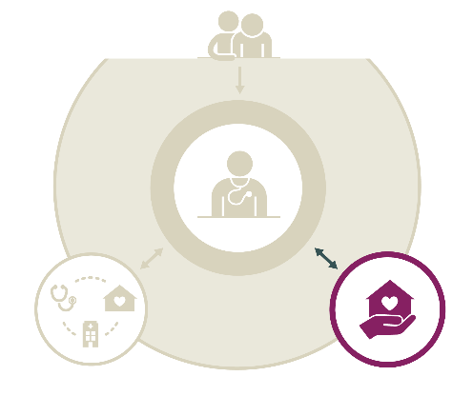
Coordination with social services
Key findings
Although many Canadian primary care physicians (60%) screen their patients for social needs, similar to the CMWF average (60%), fewer frequently coordinate care with social services (43%) compared with the CMWF average (46%). One of the biggest challenges is inadequate staffing to make referrals and coordinate (43%), though the top challenge differs across jurisdictions.
© 2020 Canadian Institute for Health Information
Notes:
How to cite this document:
Canadian Institute for Health Information. How Canada Compares: Results From the Commonwealth Fund’s 2019 International Health Policy Survey of Primary Care Physicians. Ottawa, ON: CIHI; 2020.

Slide 54
Fewer Canadian primary care physicians frequently coordinate care with social services compared with CMWF average
Proportion of primary care physicians who usually or often screen or assess patients for at least one type of social need
Proportion of primary care physicians who responded that they or other health care professionals in their practice frequently coordinate care with social services or other community providers
Note
Social needs include problems with housing, financial security, food insecurity, transportation needs, utilities, domestic violence, and social isolation or loneliness.
Between 2015 and 2019, the proportion of Canadian primary care physicians who frequently coordinate care with social services dropped from 50%¹ to 43%.
Above average
Same as average
Below average
© 2020 Canadian Institute for Health Information
Notes:
Source
Canadian Institute for Health Information. How Canada Compares: Results From The Commonwealth Fund 2015 International Health Policy Survey of Primary Care Physicians. 2016. https://www.cihi.ca/en/commonwealth-fund-survey-2015.
How to cite this document:
Canadian Institute for Health Information. How Canada Compares: Results From the Commonwealth Fund’s 2019 International Health Policy Survey of Primary Care Physicians. Ottawa, ON: CIHI; 2020.

Slide 55
Provincial and territorial snapshot: Assessing social needs and coordinating social services
Proportion of primary care physicians who . . .
 | N.L. | P.E.I. | N.S. | N.B. | Que. | Ont. | Man. | Sask. | Alta. | B.C. | Terr. | Can. | CMWF avg.
Usually or often screen or assess patients for at least one type of social need | 54 | 63 | 62 | 57 | 60 | 59 | 61 | 62 | 60 | 60 | 65 | 60 | 60
Proportion of primary care physicians who responded that they or other health care professionals in their practice . . .
 | N.L. | P.E.I. | N.S. | N.B. | Que. | Ont. | Man. | Sask. | Alta. | B.C. | Terr. | Can. | CMWF avg.
Frequently coordinate care with social services or other community providers | 51 | 61 | 43 | 41 | 32 | 47 | 49 | 52 | 40 | 47 | 53 | 43 | 46
Notes
Social needs include problems with housing, financial security, food insecurity, transportation needs, utilities, domestic violence, and social isolation or loneliness.
The CMWF average was calculated by adding the results from the 11 countries and dividing by the number of countries. The Canadian average represents the average experience of Canadians (as opposed to the mean of provincial and territorial results).
Above average
Same as average
Below average
Non-directional or no statistical tests were performed to compare with the CMWF average (e.g., territories).
© 2020 Canadian Institute for Health Information
Notes:
How to cite this document:
Canadian Institute for Health Information. How Canada Compares: Results From the Commonwealth Fund’s 2019 International Health Policy Survey of Primary Care Physicians. Ottawa, ON: CIHI; 2020.

Slide 56
Many Canadian primary care physicians experience challenges when coordinating with social services
Proportion of primary care physicians who reported the following as major challenges when they or other personnel in their practice coordinate their patients’ care with social services†
Inadequate staffing to make referrals and coordinate care with social service organizations
Lack of follow-up from social service organizations about which services patients received or need
Too much paperwork regarding coordination with social services
Lack of awareness of social service organizations in the community
Lack of a referral system or mechanism to make referrals
Notes
† Excludes respondents who answered “Do not coordinate with social services.”
Lower results are more desirable.
Above average
Same as average
Below average
© 2020 Canadian Institute for Health Information
Notes:
How to cite this document:
Canadian Institute for Health Information. How Canada Compares: Results From the Commonwealth Fund’s 2019 International Health Policy Survey of Primary Care Physicians. Ottawa, ON: CIHI; 2020.

Slide 57
Provincial and territorial snapshot: Coordination challenges with social services
Proportion of primary care physicians who reported the following as major challenges when they or other personnel in their practice coordinate their patients’ care with social services†
 | N.L. | P.E.I. | N.S. | N.B. | Que. | Ont. | Man. | Sask. | Alta. | B.C. | Terr. | Can. | CMWF avg.
Inadequate staffing to make referrals and coordinate care with social service organizations | 34 | 37* | 39 | 52 | 55 | 41 | 37 | 38 | 34 | 41 | 55 | 43 | 36
Lack of follow-up from social service organizations about which services patients received or need | 30 | 39* | 46 | 52 | 40 | 47 | 37 | 42 | 42 | 43 | 61 | 43 | 40
Too much paperwork regarding coordination with social services | 29 | 27* | 45 | 34 | 39 | 45 | 36 | 26 | 33 | 45 | 38* | 40 | 44
Lack of awareness of social service organizations in the community | 30 | — | 25 | 32 | 31 | 39 | 37 | 30 | 33 | 46 | 29* | 36 | 29
Lack of a referral system or mechanism to make referrals | 22 | 40* | 32 | 35 | 33 | 39 | 34 | 32 | 20* | 47 | 32* | 35 | 30
Notes
* The coefficient of variation (CV) is between 16.6% and 33.3%; use with caution.
— Data is suppressed due to extreme sampling variability (CV>33.3%).
† Excludes respondents who answered “Do not coordinate with social services.”
Lower results are more desirable.
The CMWF average was calculated by adding the results from the 11 countries and dividing by the number of countries. The Canadian average represents the average experience of Canadians (as opposed to the mean of provincial and territorial results).
Above average
Same as average
Below average
Non-directional or no statistical tests were performed to compare with the CMWF average (e.g., territories).
© 2020 Canadian Institute for Health Information
Notes:
How to cite this document:
Canadian Institute for Health Information. How Canada Compares: Results From the Commonwealth Fund’s 2019 International Health Policy Survey of Primary Care Physicians. Ottawa, ON: CIHI; 2020.

Slide 58
Coordination using information technologies
Key findings
More Canadian primary care physicians were using EMRs in 2019 (86%) than in 2015 (73%), but this was still lower than the CMWF average (93%).
Compared with the CMWF average, fewer Canadian primary care practices offer their patients the option to electronically view their information and make requests, including viewing test results online (Canada: 34%; CMWF: 37%), viewing patient visit summaries online (Canada: 5%; CMWF: 26%) and requesting prescription renewals online (Canada: 10%; CMWF: 52%).
Fewer Canadian primary care practices can exchange information electronically with doctors outside their practice compared with the CMWF average, including patient clinical summaries (Canada: 25%; CMWF: 63%), laboratory and diagnostic test results (Canada: 36%; CMWF: 65%) and lists of medications taken by their patients (Canada: 33%; CMWF: 62%).
Compared with the CMWF average, fewer Canadian primary care physicians review their performance on clinical outcomes (Canada: 34%; CMWF: 60%), patients’ hospital admissions (Canada: 25%; CMWF: 32%), prescribing practices (Canada: 26%; CMWF: 58%), surveys of patient satisfaction and experiences with care (Canada: 17%; CMWF: 38%) and surveys of patient-reported outcome measures (Canada: 8%; CMWF: 22%).
© 2020 Canadian Institute for Health Information
Notes:
How to cite this document:
Canadian Institute for Health Information. How Canada Compares: Results From the Commonwealth Fund’s 2019 International Health Policy Survey of Primary Care Physicians. Ottawa, ON: CIHI; 2020.

Slide 59
Canadian primary care physicians catching up in use of EMRs
Proportion of primary care physicians who use patient EMRs in their practice (not including billing systems)
Factors that contribute to greater EMR use include younger age and working primarily in physician group practices.
85% of family physicians use electronic records to enter and retrieve clinical patient notes.¹
In 2015, 73% of Canadian primary care physicians used electronic patient medical records in their practice (below the CMWF average of 88%).²
Above average
Same as average
Below average
© 2020 Canadian Institute for Health Information
Notes:
Sources
1. Canadian Medical Association. CMA Physician Workforce Survey, 2017. 2017. https://surveys.cma.ca/en/viewer?file=%2fdocuments%2fSurveyPDF%2fCMA_Survey_Workforce2017_Q22_ElectronicRecords-e.pdf#search=%22Q22.%20Use%20of%20electronic%20records%22&phrase=false.
2. Canadian Institute for Health Information. How Canada Compares: Results From The Commonwealth Fund 2015 International Health Policy Survey of Primary Care Physicians. 2016. https://www.cihi.ca/en/commonwealth-fund-survey-2015.
How to cite this document:
Canadian Institute for Health Information. How Canada Compares: Results From the Commonwealth Fund’s 2019 International Health Policy Survey of Primary Care Physicians. Ottawa, ON: CIHI; 2020.

Slide 60
Provincial and territorial snapshot: EMR use
Proportion of primary care physicians who use patient EMRs in their practice (not including billing systems)
Canada
86%
96%
CMWF
average
93%
61%
26%*
90%
92%
91%
88%
84%
89%
86%
61%
Notes
* The coefficient of variation (CV) is between 16.6% and 33.3%; use with caution.
The CMWF average was calculated by adding the results from the 11 countries and dividing by the number of countries. The Canadian average represents the average experience of Canadians (as opposed to the mean of provincial and territorial results).
Above average
Same as average
Below average
Non-directional or no statistical tests were performed to compare with the CMWF average (e.g., territories).
© 2020 Canadian Institute for Health Information
Notes:
How to cite this document:
Canadian Institute for Health Information. How Canada Compares: Results From the Commonwealth Fund’s 2019 International Health Policy Survey of Primary Care Physicians. Ottawa, ON: CIHI; 2020.

Slide 61
Electronic access to regional, provincial or territorial information systems
Proportion of primary care physicians who have electronic access to any regional (e.g., hospital/hospital network), provincial or territorial information systems where they can see patient information from outside their practice
73%
80%
93%
91%
57%
95%
92%
80%
76%
64%
57%
94%
Note
The Canadian average represents the average experience of Canadians (as opposed to the mean of provincial and territorial results).
Non-directional or no statistical tests were performed to compare with the CMWF average (e.g., territories).
© 2020 Canadian Institute for Health Information
Notes:
How to cite this document:
Canadian Institute for Health Information. How Canada Compares: Results From the Commonwealth Fund’s 2019 International Health Policy Survey of Primary Care Physicians. Ottawa, ON: CIHI; 2020.

Slide 62
Less than half of Canadian primary care physicians routinely use EMRs to support quality-of-care decisions
Proportion of primary care practices that do the following tasks routinely using a computerized system (e.g., EMR)
Send patients reminder notices when it is time for regular preventive or follow-up care (e.g., flu vaccine, HbA1c for diabetes patients)
Receive a reminder for guideline-based interventions and/or screening tests
Track all laboratory tests that are ordered until results reach clinicians
Receive an alert or prompt to provide patients with test results
2019
Above average
Same as average
Below average
© 2020 Canadian Institute for Health Information
Notes:
How to cite this document:
Canadian Institute for Health Information. How Canada Compares: Results From the Commonwealth Fund’s 2019 International Health Policy Survey of Primary Care Physicians. Ottawa, ON: CIHI; 2020.

Slide 63
Provincial and territorial snapshot: Quality-of-care functionalities
Proportion of primary care practices that do the following tasks routinely using a computerized system (e.g., EMR)
 | N.L. | P.E.I. | N.S. | N.B. | Que. | Ont. | Man. | Sask. | Alta. | B.C. | Terr. | Can. | CMWF avg.
Send patients reminder notices when it is time for regular preventive or follow-up care | 8* | — | 17* | 14* | 6* | 31 | 26 | 37 | 41 | 35 | — | 26 | 51
Receive a reminder for guideline-based interventions and/or screening tests | 18* | — | 22* | 27 | 15 | 52 | 47 | 38 | 53 | 40 | 18* | 38 | 40
Track all laboratory tests that are ordered until results reach clinicians | 50 | — | 58 | 26 | 39 | 48 | 58 | 61 | 59 | 61 | 41* | 49 | 67
Receive an alert or prompt to provide patients with test results | 35 | — | 38 | 21* | 30 | 44 | 47 | 54 | 49 | 45 | 33* | 41 | 40
Notes
* The coefficient of variation (CV) is between 16.6% and 33.3%; use with caution.
— Data is suppressed due to extreme sampling variability (CV>33.3%).
The CMWF average was calculated by adding the results from the 11 countries and dividing by the number of countries. The Canadian average represents the average experience of Canadians (as opposed to the mean of provincial and territorial results).
Above average
Same as average
Below average
Non-directional or no statistical tests were performed to compare with the CMWF average (e.g., territories).
© 2020 Canadian Institute for Health Information
Notes:
How to cite this document:
Canadian Institute for Health Information. How Canada Compares: Results From the Commonwealth Fund’s 2019 International Health Policy Survey of Primary Care Physicians. Ottawa, ON: CIHI; 2020.

Slide 64
Fewer Canadian primary care practices can communicate electronically with patients compared with CMWF average
Proportion of primary care physicians whose practice offers their patients the option to . . .
View test results online†
View patient visit summaries online
Request prescription renewals online††
2019
Notes
† Wording of the question was modified slightly from “view test results on a secure website” in 2015.
‡ n/a: CMWF average is not available because the question was asked only in Canada in 2015.
§ n/a: Data is not available because this was a new question in 2019.
†† Wording of the question was modified slightly from “request refills for prescriptions online” in 2015.
In 2016, 6% of Canadians viewed health information online or downloaded it (e.g., test or laboratory results).¹
In 2017, 2% of Canadian family physicians reported that patients in their practice could electronically add text and/or other documentation to their electronic record.²
Above average
Same as average
Below average
© 2020 Canadian Institute for Health Information
Notes:
Sources
Canadian Institute for Health Information. How Canada Compares: Results From The Commonwealth Fund’s 2016 International Health Policy Survey of Adults in 11 Countries. 2017. https://www.cihi.ca/en/commonwealth-fund-survey-2016.
Canadian Medical Association. CMA Physician Workforce Survey, 2017. 2017. https://surveys.cma.ca/en/viewer?file=%2fdocuments%2fSurveyPDF%2fCMA_Survey_Workforce2017_Q24_ElectronicToolsPatients-e.pdf#search="Q24.%20Electronic%20tools%20used%20by%20patients"&phrase=false.
How to cite this document:
Canadian Institute for Health Information. How Canada Compares: Results From the Commonwealth Fund’s 2019 International Health Policy Survey of Primary Care Physicians. Ottawa, ON: CIHI; 2020.

Slide 65
Provincial and territorial snapshot: Electronic communication options for patients
Proportion of primary care physicians whose practice offers their patients the option to . . .
 | N.L. | P.E.I. | N.S. | N.B. | Que. | Ont. | Man. | Sask. | Alta. | B.C. | Terr. | Can. | CMWF avg.
View test results online | — | — | 32 | — | 37 | 42 | 13* | 11* | 15* | 49 | 0 | 34 | 37
View patient visit summaries online | — | — | 8* | — | 3* | 6 | — | 7* | — | — | 0 | 5 | 26
Request prescription renewals online | — | 0 | 12* | — | 8 | 15 | 12* | 12* | — | — | 0 | 10 | 52
Notes
* The coefficient of variation (CV) is between 16.6% and 33.3%; use with caution.
— Data is suppressed due to extreme sampling variability (CV>33.3%).
The CMWF average was calculated by adding the results from the 11 countries and dividing by the number of countries. The Canadian average represents the average experience of Canadians (as opposed to the mean of provincial and territorial results).
Above average
Same as average
Below average
Non-directional or no statistical tests were performed to compare with the CMWF average (e.g., territories).
© 2020 Canadian Institute for Health Information
Notes:
How to cite this document:
Canadian Institute for Health Information. How Canada Compares: Results From the Commonwealth Fund’s 2019 International Health Policy Survey of Primary Care Physicians. Ottawa, ON: CIHI; 2020.

Slide 66
Fewer Canadian primary care practices can communicate electronically with other practices compared with CMWF average
Proportion of primary care physicians who can electronically exchange the following with any doctors outside their practice
Patient clinical summaries
Laboratory and diagnostic test results
Lists of all medications taken by an individual patient
2019
Note
n/a: Data is not available because this was a new question in 2019.
Above average
Same as average
Below average
© 2020 Canadian Institute for Health Information
Notes:
How to cite this document:
Canadian Institute for Health Information. How Canada Compares: Results From the Commonwealth Fund’s 2019 International Health Policy Survey of Primary Care Physicians. Ottawa, ON: CIHI; 2020.

Slide 67
Provincial and territorial snapshot: Electronic communication with other practices
Proportion of primary care physicians who can electronically exchange the following with any doctors outside their practice
 | N.L. | P.E.I. | N.S. | N.B. | Que. | Ont. | Man. | Sask. | Alta. | B.C. | Terr. | Can. | CMWF avg.
Patient clinical summaries | 35 | — | 31 | 13* | 15 | 30 | 33 | 44 | 18* | 26 | 44* | 25 | 63
Laboratory and diagnostic test results | 42 | 43* | 36 | 20* | 40 | 35 | 45 | 57 | 30 | 29 | 45 | 36 | 65
Lists of all medications taken by an individual patient | 46 | — | 34 | 19* | 39 | 29 | 41 | 54 | 29 | 26 | 45 | 33 | 62
Notes
* The coefficient of variation (CV) is between 16.6% and 33.3%; use with caution.
— Data is suppressed due to extreme sampling variability (CV>33.3%).
The CMWF average was calculated by adding the results from the 11 countries and dividing by the number of countries. The Canadian average represents the average experience of Canadians (as opposed to the mean of provincial and territorial results).
Above average
Same as average
Below average
Non-directional or no statistical tests were performed to compare with the CMWF average (e.g., territories).
© 2020 Canadian Institute for Health Information
Notes:
How to cite this document:
Canadian Institute for Health Information. How Canada Compares: Results From the Commonwealth Fund’s 2019 International Health Policy Survey of Primary Care Physicians. Ottawa, ON: CIHI; 2020.

Slide 68
Fewer Canadian primary care physicians review their performance in patient care at least annually compared with CMWF average
Proportion of primary care physicians whose practice receives and reviews data on the following aspects of their patients’ care, quarterly or yearly
Clinical outcomes (e.g., percentage of diabetes or asthma patients with good control)
Patients’ hospital admissions or emergency department use
Prescribing practices (e.g., use of generic drugs, antibiotics or opioids)
Surveys of patient satisfaction and experiences with care
Surveys of patient-reported outcome measures (PROMs)
Above average
Same as average
Below average
© 2020 Canadian Institute for Health Information
Notes:
How to cite this document:
Canadian Institute for Health Information. How Canada Compares: Results From the Commonwealth Fund’s 2019 International Health Policy Survey of Primary Care Physicians. Ottawa, ON: CIHI; 2020.

Slide 69
Provincial and territorial snapshot: Performance review
Proportion of primary care physicians whose practice receives and reviews data on the following aspects of their patients’ care, quarterly or yearly
 | N.L. | P.E.I. | N.S. | N.B. | Que. | Ont. | Man. | Sask. | Alta. | B.C. | Terr. | Can. | CMWF avg.
Clinical outcomes | 23 | — | 29 | 50 | 14 | 40 | 37 | 31 | 51 | 37 | 25* | 34 | 60
Patients’ hospital admissions or emergency department use | 15* | 34* | 17* | 40 | 19 | 30 | 23* | 26 | 29 | 19* | — | 25 | 32
Prescribing practices | 24 | — | 19* | 22 | 10 | 29 | 30 | 19* | 59 | 22* | — | 26 | 58
Surveys of patient satisfaction and experiences with care | 10* | — | 9* | 11* | 5* | 22 | 17* | 28 | 32 | 11* | — | 17 | 38
Surveys of patient-reported outcome measures (PROMs) | 9* | 0 | — | — | 3* | 8 | 11* | 16* | 21* | — | — | 8 | 22
Notes
* The coefficient of variation (CV) is between 16.6% and 33.3%; use with caution.
— Data is suppressed due to extreme sampling variability (CV>33.3%).
The CMWF average was calculated by adding the results from the 11 countries and dividing by the number of countries. The Canadian average represents the average experience of Canadians (as opposed to the mean of provincial and territorial results).
Above average
Same as average
Below average
Non-directional or no statistical tests were performed to compare with the CMWF average (e.g., territories).
© 2020 Canadian Institute for Health Information
Notes:
How to cite this document:
Canadian Institute for Health Information. How Canada Compares: Results From the Commonwealth Fund’s 2019 International Health Policy Survey of Primary Care Physicians. Ottawa, ON: CIHI; 2020.

Slide 70
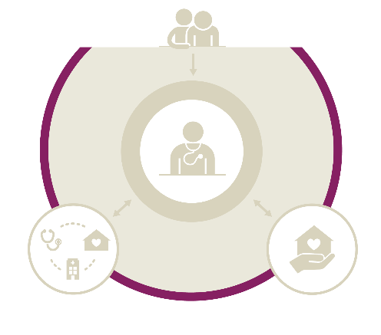
Perception of health system performance
Key findings
22% of Canadian primary care physicians think that the quality of medical care their patients receive throughout the health system has improved compared with 3 years ago, higher than the CMWF average (19%).
62% of Canadian primary care physicians rated the overall performance of the health care system as very good or good, lower than the CMWF average (70%).
65% of Canadian primary care physicians think that better integration of primary care with hospitals, mental health services and community-based social services is the top priority in improving quality of care and patient access.
© 2020 Canadian Institute for Health Information
Notes:
How to cite this document:
Canadian Institute for Health Information. How Canada Compares: Results From the Commonwealth Fund’s 2019 International Health Policy Survey of Primary Care Physicians. Ottawa, ON: CIHI; 2020.

Slide 71
More Canadian primary care physicians think quality improved, fewer rate overall performance favourably compared with CMWF average
Proportion of primary care physicians who think the quality of medical care their patients receive throughout the health care system has improved, has become worse or is about the same as 3 years ago
Proportion of primary care physicians who rate the overall performance of the health care system as very good or good
Above average
Same as average
Below average
© 2020 Canadian Institute for Health Information
Notes:
How to cite this document:
Canadian Institute for Health Information. How Canada Compares: Results From the Commonwealth Fund’s 2019 International Health Policy Survey of Primary Care Physicians. Ottawa, ON: CIHI; 2020.

Slide 72
Provincial and territorial snapshot: Overall perceptions
Proportion of primary care physicians who think the quality of medical care their patients receive throughout the health care system has improved or has become worse compared with 3 years ago
 | N.L. | P.E.I. | N.S. | N.B. | Que. | Ont. | Man. | Sask. | Alta. | B.C. | Terr. | Can. | CMWF avg.
Improved | 24 | — | — | 16* | 29 | 14 | 20* | 42 | 29 | 24 | 26* | 22 | 19
Worse | 16* | 24* | 57 | 24 | 21 | 35 | 20* | 11* | 11* | 23* | 17* | 25 | 31
Proportion of primary care physicians who rate the overall performance of the health care system as . . .
 | N.L. | P.E.I. | N.S. | N.B. | Que. | Ont. | Man. | Sask. | Alta. | B.C. | Terr. | Can. | CMWF avg.
Very good or good | 66 | 53 | 42 | 70 | 70 | 54 | 61 | 71 | 73 | 54 | 74 | 62 | 70
Notes
* The coefficient of variation (CV) is between 16.6% and 33.3%; use with caution.
— Data is suppressed due to extreme sampling variability (CV>33.3%).
The CMWF average was calculated by adding the results from the 11 countries and dividing by the number of countries. The Canadian average represents the average experience of Canadians (as opposed to the mean of provincial and territorial results).
Above average
Same as average
Below average
Non-directional or no statistical tests were performed to compare with the CMWF average (e.g., territories).
© 2020 Canadian Institute for Health Information
Notes:
How to cite this document:
Canadian Institute for Health Information. How Canada Compares: Results From the Commonwealth Fund’s 2019 International Health Policy Survey of Primary Care Physicians. Ottawa, ON: CIHI; 2020.

Slide 73
Better integration of care across health and social systems identified as top priority
Proportion of primary care physicians who responded that the following strategies are the top priority in order to improve quality of care and patient access
Better integrate primary care with hospitals, mental health services and community-based social services
Reduce wait times for elective surgery and specialists
Increase spending on disease prevention and/or public health
Increase access to and funding for social care programs (e.g., housing, food, employment support)
Reduce prescription drug prices
Reduce cost-sharing, deductibles and co-payments for patients
Non-directional or no statistical tests were performed to compare with the CMWF average (e.g., territories).
© 2020 Canadian Institute for Health Information
Notes:
How to cite this document:
Canadian Institute for Health Information. How Canada Compares: Results From the Commonwealth Fund’s 2019 International Health Policy Survey of Primary Care Physicians. Ottawa, ON: CIHI; 2020.

Slide 74
Provincial and territorial snapshot: Improvement strategies
Proportion of primary care physicians who responded that the following strategies are the top priority in order to improve quality of care and patient access
 | N.L. | P.E.I. | N.S. | N.B. | Que. | Ont. | Man. | Sask. | Alta. | B.C. | Terr. | Can. | CMWF avg.
Better integrate primary care with hospitals, mental health services and community-based social services | 68 | 68 | 56 | 64 | 73 | 65 | 60 | 70 | 56 | 61 | 64 | 65 | 57
Reduce wait times for elective surgery and specialists | 59 | 57 | 59 | 49 | 51 | 55 | 61 | 56 | 59 | 58 | 23* | 55 | 35
Increase spending on disease prevention and/or public health | 51 | 47* | 43 | 51 | 42 | 38 | 47 | 49 | 40 | 36 | 34* | 40 | 43
Increase access to and funding for social care programs (e.g., housing, food, employment support) | 39 | 46* | 41 | 45 | 35 | 37 | 41 | 41 | 31 | 39 | 66 | 38 | 35
Reduce prescription drug prices | 50 | 53* | 42 | 43 | 32 | 31 | 46 | 50 | 41 | 49 | 19* | 37 | 24
Reduce cost-sharing, deductibles and co-payments for patients | 18* | — | 16* | 16* | 8 | 14 | 16* | 15* | 11* | 15* | — | 13 | 16
Notes
* The coefficient of variation (CV) is between 16.6% and 33.3%; use with caution.
— Data is suppressed due to extreme sampling variability (CV>33.3%).
The CMWF average was calculated by adding the results from the 11 countries and dividing by the number of countries. The Canadian average represents the average experience of Canadians (as opposed to the mean of provincial and territorial results).
Non-directional or no statistical tests were performed to compare with the CMWF average (e.g., territories).
© 2020 Canadian Institute for Health Information
Notes:
How to cite this document:
Canadian Institute for Health Information. How Canada Compares: Results From the Commonwealth Fund’s 2019 International Health Policy Survey of Primary Care Physicians. Ottawa, ON: CIHI; 2020.

Slide 75
Physicians identified patient requests as biggest barrier to reducing low-value or potentially wasteful care in Canada
In some countries, increasing attention is being given to treatments that may be of low value or that could potentially be wasteful. Proportion of primary care physicians who responded that the following are major barriers to reducing low-value or potentially wasteful care
Patient requests for unnecessary tests and treatments
Lack of time for shared decision-making with patients
Medical malpractice environment
Lack of tools or decision aids to help determine whether a patient will benefit from a service
Many Canadians are aware that there are medical tests and treatments that can be unnecessary, but they need more support or tools in deciding whether to use them.¹
Non-directional or no statistical tests were performed to compare with the CMWF average (e.g., territories).
© 2020 Canadian Institute for Health Information
Notes:
Source
Canadian Institute for Health Information. Unnecessary Care in Canada. 2017. https://www.cihi.ca/sites/default/files/document/choosing-wisely-baseline-report-en-web.pdf.
How to cite this document:
Canadian Institute for Health Information. How Canada Compares: Results From the Commonwealth Fund’s 2019 International Health Policy Survey of Primary Care Physicians. Ottawa, ON: CIHI; 2020.

Slide 76
Provincial and territorial snapshot: Barriers to reducing low-value care
Proportion of primary care physicians who responded that the following are major barriers to reducing low-value or potentially wasteful care
 | N.L. | P.E.I. | N.S. | N.B. | Que. | Ont. | Man. | Sask. | Alta. | B.C. | Terr. | Can. | CMWF avg.
Patient requests for unnecessary tests and treatments | 63 | 50* | 61 | 58 | 35 | 71 | 53 | 58 | 65 | 57 | 62 | 58 | 57
Lack of time for shared decision-making with patients | 37 | 37* | 42 | 38 | 28 | 41 | 41 | 34 | 29 | 42 | 51 | 37 | 41
Medical malpractice environment | 25 | 25* | 31 | 16* | 13 | 38 | 23* | 25 | 26* | 26 | 35* | 27 | 40
Lack of tools or decision aids to help determine whether a patient will benefit from a service | 24 | 36* | 22* | 23 | 23 | 23 | 24 | 22 | 20* | 28 | 20* | 23 | 27
Notes
* The coefficient of variation (CV) is between 16.6% and 33.3%; use with caution.
The CMWF average was calculated by adding the results from the 11 countries and dividing by the number of countries. The Canadian average represents the average experience of Canadians (as opposed to the mean of provincial and territorial results).
Non-directional or no statistical tests were performed to compare with the CMWF average (e.g., territories).
© 2020 Canadian Institute for Health Information
Notes:
How to cite this document:
Canadian Institute for Health Information. How Canada Compares: Results From the Commonwealth Fund’s 2019 International Health Policy Survey of Primary Care Physicians. Ottawa, ON: CIHI; 2020.

Slide 77
Methodology notes
The CMWF’s 2019 International Health Policy Survey of Primary Care Physicians includes responses from primary care physicians in 11 countries: Australia, Canada, France, Germany, the Netherlands, New Zealand, Norway, Sweden, Switzerland, the United Kingdom and the United States.
More detailed methodology notes, including a complete list of response rates from all countries surveyed, are available online.
In Canada, Social Science Research Solutions (SSRS) conducted mail and online surveys from January 29 to June 3, 2019, for the provinces (except P.E.I.), and censuses of P.E.I. and the territories from February 27 to July 30, 2019. In addition to the base sample funded by the CMWF, sample sizes were increased in Quebec and Ontario with funding from provincial organizations, and in the rest of the provinces and territories with funding from CIHI. Primary care physicians were randomly selected in the provinces (except P.E.I.); all primary care physicians in P.E.I. and the territories were invited to participate. To encourage participation, an incentive cheque of $25 or $100 was provided for each primary care physician selected in the provinces and territories, respectively. In total, there were 2,569 respondents in Canada, for an overall response rate of 39.3%.
Due to small sample sizes in Yukon, the Northwest Territories and Nunavut, the results from the territories are reported together (with permission and support).
© 2020 Canadian Institute for Health Information
Notes:
How to cite this document:
Canadian Institute for Health Information. How Canada Compares: Results From the Commonwealth Fund’s 2019 International Health Policy Survey of Primary Care Physicians. Ottawa, ON: CIHI; 2020.

Slide 78
Methodology notes (continued)
Weighting of results
The survey data for Canada was first weighted by age and gender (for Ontario, Quebec and the rest of Canada). The weights were subsequently adjusted to reflect the share of each jurisdiction among Canadian primary care physicians. Benchmarks for physician distribution were derived from the CMA Masterfile, January 2018, Canadian Medical Association.
Averages and trends
For this chartbook, the CMWF average was calculated by adding the results from the 11 countries and dividing by the number of countries. The Canadian average represents the average experience of Canadians (as opposed to the mean of provincial and territorial results). Except where otherwise noted, results were compared over time using data from previous CMWF surveys.
Trending results are for reference only, and caution should be used when interpreting the results. Some questions were modified compared with the 2015 survey (e.g., question text revised, response options added, question placement changed, translation changed).
© 2020 Canadian Institute for Health Information
Notes:
How to cite this document:
Canadian Institute for Health Information. How Canada Compares: Results From the Commonwealth Fund’s 2019 International Health Policy Survey of Primary Care Physicians. Ottawa, ON: CIHI; 2020.

Slide 79
Methodology notes (continued)
Statistical analysis
Consistent with other published reports on CMWF data,¹ non-response categories such as “not sure,” “declined to answer” and “not applicable” were excluded from reporting and statistical analyses.
CIHI developed statistical methods to determine whether
Canadian results were significantly different from the average of 11 countries; and
Provincial results were significantly different from the international average.
For the calculation of variances and confidence intervals, standard methods for the variances of sums and differences of estimates from independent simple random samples were used, with the design effects provided by SSRS used to appropriately adjust the variances for the effects of the survey design and post-survey weight adjustments. Coefficients of variation were calculated by dividing the standard error by the estimate.
Relationships between different variables were analyzed using logistic regression modelling. A main response category was determined for each question, and responses were dichotomized such that the response value of interest was coded as 1 and all other values, excluding non-response categories, were coded as 0. Logistic regression was then used to fit this binary variable on explanatory variables with appropriate adjustment for survey weights and stratification variables using the SAS procedure SURVEYLOGISTIC for the analysis.
© 2020 Canadian Institute for Health Information
Notes:
Source
Osborn R, Moulds D, Squires M, Doty M, Anderson C. International survey of older adults finds shortcomings in access, coordination, and patient-centered care. Health Affairs. 2014. https://www.ncbi.nlm.nih.gov/pubmed/25410260.
How to cite this document:
Canadian Institute for Health Information. How Canada Compares: Results From the Commonwealth Fund’s 2019 International Health Policy Survey of Primary Care Physicians. Ottawa, ON: CIHI; 2020.

Slide 80
Demographics of survey respondents (unweighted)
 | N.L. | P.E.I. | N.S. | N.B. | Que. | Ont. | Man. | Sask. | Alta. | B.C. | Terr. | Can.
Total | 192 | 44 | 186 | 196 | 464 | 597 | 186 | 206 | 177 | 203 | 51† | 2,569
Gender
Male | 56% | 75% | 54% | 44% | 47% | 50% | 54% | 60% | 58% | 56% | 41% | 52%
Female | 44% | 25% | 44% | 55% | 52% | 49% | 45% | 39% | 41% | 44% | 59% | 47%
Age
<35 | 9% | 11% | 7% | 19% | 25% | 16% | 13% | 10% | 20% | 10% | 18% | 16%
35–44 | 33% | 20% | 22% | 20% | 17% | 21% | 27% | 32% | 33% | 27% | 33% | 24%
45–54 | 31% | 25% | 27% | 28% | 17% | 23% | 22% | 28% | 14% | 23% | 18% | 23%
55–64 | 14% | 25% | 25% | 25% | 27% | 23% | 24% | 17% | 22% | 28% | 18% | 23%
65+ | 14% | 18% | 18% | 8% | 13% | 16% | 13% | 13% | 10% | 12% | 14% | 13%
Geographic location (self-identified)
City/suburb | 44% | 34% | 44% | 40% | 64% | 77% | 62% | 51% | 72% | 68% | 10% | 59%
Small town/rural area/remote area | 54% | 66% | 54% | 59% | 34% | 21% | 36% | 48% | 25% | 31% | 80% | 39%
Note
† Both local and locum physicians were surveyed in the territories. Only local physicians were included in the “total territories” analyses, whereas both local and locum physicians were included in the Canada-level analyses. As a result, the sum of the number of physicians by jurisdiction does not equal the Canada total.
© 2020 Canadian Institute for Health Information
Notes:
How to cite this document:
Canadian Institute for Health Information. How Canada Compares: Results From the Commonwealth Fund’s 2019 International Health Policy Survey of Primary Care Physicians. Ottawa, ON: CIHI; 2020.

Slide 81
Bibliography
Canadian Institute for Health Information. How Canada Compares: Results From The Commonwealth Fund 2015 International Health Policy Survey of Primary Care Physicians. 2016. https://www.cihi.ca/en/commonwealth-fund-survey-2015.
Canadian Institute for Health Information. How Canada Compares: Results From The Commonwealth Fund’s 2016 International Health Policy Survey of Adults in 11 Countries. 2017. https://www.cihi.ca/en/commonwealth-fund-survey-2016.
Canadian Institute for Health Information. How Canada Compares: Results From The Commonwealth Fund’s 2017 International Health Policy Survey of Seniors. 2018. https://www.cihi.ca/sites/default/files/document/commonwealth-survey-2017- chartbook-en-rev2-web.pptx.
Canadian Institute for Health Information. Unnecessary Care in Canada. 2017. https://www.cihi.ca/sites/default/files/document/choosing-wisely-baseline-report-en-web.pdf.
Canadian Medical Association. CMA Physician Workforce Survey, 2017. 2017. https://surveys.cma.ca/.
Canadian Medical Association. Family Medicine Profile. 2018. https://www.cma.ca/sites/default/files/2019-01/family-e.pdf.
Downar J. Resources for educating, training, and mentoring all physicians providing palliative care. Journal of Palliative Medicine. 2018. https://doi.org/10.1089/jpm.2017.0396.
Health Canada. Fourth Interim Report on Medical Assistance in Dying in Canada. 2019. https://www.canada.ca/en/ health-canada/services/publications/health-system-services/medical-assistance-dying-interim-report-april-2019.html.
© 2020 Canadian Institute for Health Information
Notes:
How to cite this document:
Canadian Institute for Health Information. How Canada Compares: Results From the Commonwealth Fund’s 2019 International Health Policy Survey of Primary Care Physicians. Ottawa, ON: CIHI; 2020.

Slide 82
Bibliography (continued)
Osborn R, Moulds D, Squires M, Doty M, Anderson C. International survey of older adults finds shortcomings in access, coordination, and patient-centered care. Health Affairs. 2014. https://www.ncbi.nlm.nih.gov/pubmed/25410260.
Statistics Canada. Section 7: Data quality. Accessed October 21, 2019. https://www150.statcan.gc.ca/n1/pub/71-543-g/ 2016001/part-partie7-eng.htm.
The College of Family Physicians of Canada. Standards of Accreditation for Residency Programs in Family Medicine. 2018. https://www.cfpc.ca/uploadedFiles/_Shared_Elements/Documents/20180701_RB_V1.2_ENG.pdf.
© 2020 Canadian Institute for Health Information
Notes:
How to cite this document:
Canadian Institute for Health Information. How Canada Compares: Results From the Commonwealth Fund’s 2019 International Health Policy Survey of Primary Care Physicians. Ottawa, ON: CIHI; 2020.

